Slide 1
Prognosis
Neural recovery during rehabilitation is common and can result insignificant improvement in function. In patients with complete injuries, muscles in the zone of partial preservation strengthen, which may result insignificant functional change. This is true especially if a key muscle, such as extensor carpiradialis, strengthens enough to enable the person to extend the wrist and hold objects. Patients with incomplete injury have a better prognosis, and their spontaneous recovery is less predictable in its pattern and outcome than patients with complete injury
https://manara.edu.sy/

Slide 2
Immediately after the injury, all reflexes cease to function. When spinal shock resolves, patients have an excellent chance to regain motor and sensory function. As time after injury increases, however, the recovery rate declines. Most motor and sensory spontaneous return in both complete and incomplete injuries occurs in the first 3 months post onset. The rate of recovery declines but persists for up to 18 months or longer.
https://manara.edu.sy/

Slide 3
it is important that the therapist maintain hope while planning a realistic course of treatment. Research data can assist the clinician in predicting recovery and outcomes. The therapist should be sensitive and cautious about sharing this information with patients when they are most vulnerable.
Long-term survival of people with SCI has improved dramatically over the past 50 years and is only slightly less than the general population. The major causes of death are respiratory complications and infections (NSCISC, 2010).
https://manara.edu.sy/

Slide 4
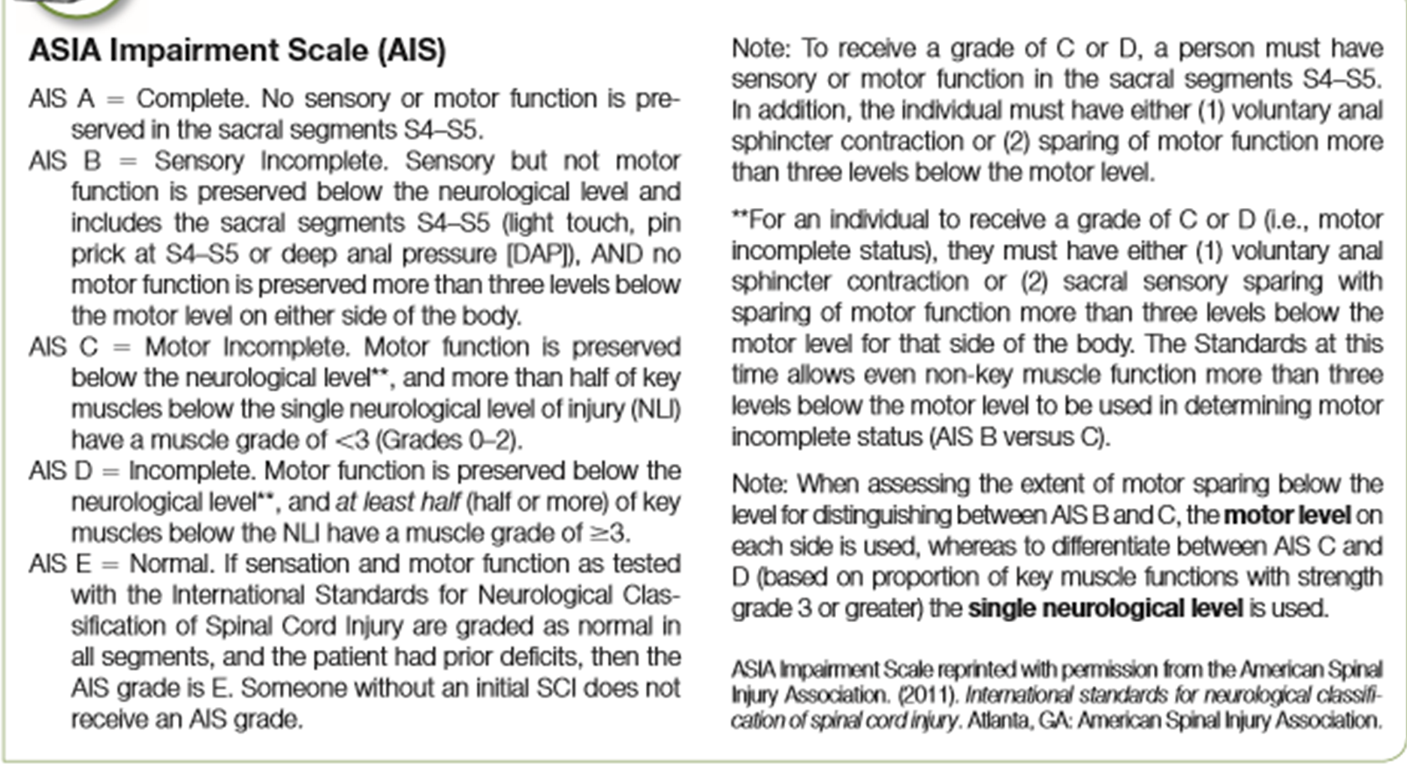
https://manara.edu.sy/

Slide 5
Impairments and Their Therapeutic Implications
Respiration:
Many patients with SCI have compromised breathing especially for individuals with cervical injuries. Respiratory complications, specifically pneumonia, have been identified as the leading cause of death in the first year of life after SCI.
In lesions above C4, damage to the phrenic nerve results in partial or complete paralysis of the diaphragm. These patients require mechanical ventilation.
https://manara.edu.sy/

Slide 6
Lower cervical and thoracic spine injuries can result in paralysis of other breathing muscles, such as the intercostals, abdominals, or latissimus dorsi. Thus, patients with such injuries also have impaired respiration.
Use of proper techniques and infection control standards are important for respiratory care. Under the direction of the physician, the physical and respiratory therapists and the health care team work to achieve adequate bronchial hygiene and to facilitate good breathing at rest and during activities. Good communication with the team allows the occupational therapist to support breathing goals.
https://manara.edu.sy/

Slide 7
Autonomic Dysreflexia
Autonomic dysreflexia, a sudden dangerous increase in blood pressure, is a possibly life-threatening complication associated with lesions at the T6 level or above. It is brought on by an unopposed sympathetic response to noxious stimuli. Some of the more common causes of autonomic dysreflexia are distended bladder, urinary tract or other infection, bladder or kidney stones, fecal impaction, pressure ulcers, ingrown toenails, invasive procedures such as urinary catheterization or enema, and pain. The main symptoms are hypertension and a pounding headache.
https://manara.edu.sy/

Slide 8
An increase of 20 mm Hg or more in systolic blood pressure is a sign that must be attended to. A pounding headache is the most common symptom. Other signs and symptoms include heavy sweating, flushed skin, goose bumps, blurry vision, a stuffy nose, anxiety, difficulty breathing, and chest tightness. Take the following steps:
Ask the person to stop any ongoing activity, as it may further increase blood pressure
Check blood pressure. If high:
Have the person sit up with head elevated to avoid excessive blood pressure to the brain.
Loosen clothing, abdominal binder, and any other constrictive devices.
Check the urinary catheter for kinks or folds and straighten any.
Continue to monitor blood pressure and seek medical assistance, which may include bladder irrigation, manual fecal evacuation, and medications.
https://manara.edu.sy/

Slide 9
Orthostatic Hypotension or Postural Hypotension
Orthostatic hypotension is a sudden drop in blood pressure occurring when a person assumes an upright position. Most common in patients with lesions at the T6 level and above, it is caused by impaired autonomic regulation.
A decrease occurs in the returning blood supply to the heart, commonly because of blood pooling in the lower extremities. Orthostatic hypotension is aggravated by a prolonged stay in bed. When the patient attempts to sit up, the blood rushes down to the legs. The patient may complain of light-headedness or dizziness and may faint on moving from reclined to upright. The therapist must use caution when sitting the patient up by having the patient move slowly and in stages and letting the blood pressure adjust to the change.
Elevating the head of the bed, using a tilt table, or using a reclining wheelchair can accomplish this. To control this problem further, patients benefit from wearing abdominal binders and elastic stockings.
https://manara.edu.sy/

Slide 10
In contrast to autonomic dysreflexia, in orthostatic hypotension, blood pressure drops to dangerously low levels in response to assuming an upright position. If it is not treated immediately, the person may lose consciousness. Symptoms of orthostatic hypotension include light-headedness, pallor, and visual changes. To resolve the problem:
Check blood pressure.
If the person is in bed, lower the head of the bed.
If the person is in a wheelchair, lift his or her legs and observe for signs of relief. If symptoms persist, recline the wheelchair to place the head at or below the level of the heart.
If symptoms persist, put the patient to bed.
Continue to monitor blood pressure and seek medical assistance. Do not leave the patient unattended until a nurse or a physician is present
https://manara.edu.sy/

Slide 11
Pressure Ulcers and the Maintenance of Skin Integrity
Individuals with SCI are in perpetual danger of developing pressure ulcers. Most patients do not have the sensory feedback that periodically cues them to shift position in their bed or wheelchair. The constant pressure caused by maintaining a static position without shifting weight can lead to skin breakdown. All individuals with SCI must adhere to a weight-shifting pressure- relief schedule. Generally, in the wheelchair, people that have strong upper limbs perform pressure relief by leaning forward or side to side. Individuals that cannot perform these skills must rely on a powered wheelchair that tilts back (either a tilt-in-space wheelchair or one that reclines).
https://manara.edu.sy/

Slide 12
Although most pressure-relief efforts are aimed at the buttocks, many other parts of the body are vulnerable.
All insensate areas must be inspected daily. For high tetraplegic patients, these areas may also include the spine of the scapula and the back of the head.
Individuals with SCI incorporate this practice in their daily routines following hospitalization. They must become responsible for carrying out pressure-relief procedures themselves or for asking assistance in doing so. This may sound easy, but data suggest that most people with SCI develop at least one pressure ulcer during their lifetime.
https://manara.edu.sy/

Slide 13
This underscores the challenge of living life fully while having to stay vigilant, perform routine thorough skin inspections, shift weight routinely, maintain equipment in good repair, and make minute-by-minute choices about activity levels and durations.
Recent research suggests that intervals of 2 minutes of pressure relief every hour while seated in the wheelchair is required for tissue oxygen perfusion, rather than 1 minute as previously thought. While in bed, people with SCI must change position every 2 hours.
https://manara.edu.sy/

Slide 14
Any client interaction must be viewed as an opportunity for a “teachable moment”. Educational materials, such as the Consortium for Spinal Cord Medicine Clinical Practice Guidelines, Consumer Guides—Pressure Ulcers: What You Should Know (2002) and www.PressureUlcerPrevention.com, a user-friendly website for consumers and therapists, are helpful supplements for reinforcing the program. However, education is not enough to prevent ulcers.
https://manara.edu.sy/

Slide 15
Examples of occupational therapy roles in pressure ulcer prevention include
training in motor skills, such as checking the skin in bed and in the wheelchair
establishing routines, such as inspecting and wiping any wetness in vulnerable areas
assessing environmental and contextual factors, such as helping select high-protein, healthy foods when going to the market
recommending appropriate equipment such as seating systems, cushions, and padded shower chairs
assisting in creating a typical day that allows for rest periods and other preventive measures
https://manara.edu.sy/

Slide 16
Bowel and Bladder Function and Management
Bowel and bladder function is controlled in the S2–S5 spinal segments. Therefore, all persons with complete lesions at and above the S2–S5 levels lose their ability to void and defecate voluntarily. With the presence of intact reflex activity but with a lack of cortical voluntary control, patients void and defecate reflexively. Incomplete injuries and disruption at the S2–S5 levels, as seen in conus medullaris and cauda equina, may present with a mixed sensory and/or motor picture. For example, a person may feel the urge but may lack the ability to void and defecate voluntarily. The goal of a sound bowel and bladder program is to allow the person to develop an elimination routine that supports health, reduces potential complications, and allows the freedom to engage in life roles without disruption.
https://manara.edu.sy/

Slide 17
Following a thorough medical examination that includes studies of the structure and function of the digestive and urinary tracts, a physician establishes a safe elimination program. Most programs involve behavioural and pharmacological interventions. Surgery is also an option that is typically offered years postinjury to further ease elimination and reduce problems.
https://manara.edu.sy/

Slide 18
Nurses are the primary trainers of bowel and bladder routines, and occupational therapists have a vital role in supporting the acquisition of these new skills and habits. A typical bowel program for a person with paraplegia includes taking oral medications to allow for optimal feces consistency and establishing a daily routine of transferring to the toilet, managing clothing, inserting a suppository, and, after waiting for some time, inserting a finger to the anus (called digital stimulation), which causes reflexive defecation. The occupational therapist may assist in facilitating skill acquisition in a person with poor vision and/or cognitive deficits.
https://manara.edu.sy/

Slide 19
A magnifying mirror and a lamp may be placed on the floor to help the person see the process, which helps to further break down the activity to better reinforce each step. Persons with low tetraplegia have added challenges in becoming independent in bowelcare. They may achieve independence or assist in managing their bowel care only after much practice. To compensate for poor trunk control, individuals perform the bowel program on a commode; to compensate for finger paralysis, they require a tool called a dill stick to stimulate the anal reflex to defecate; and to compensate for lack of sensation in the anus and/or parts of the hand, they require a mirror.
https://manara.edu.sy/

Slide 20
https://manara.edu.sy/

Slide 21
For safe task performance, occupational therapists may practice commode mobility and dill stick insertion, focusing on effective visual compensation.
When patients become skilful at bowel evacuation practices, they decrease the risk of complications. Most individuals, after discharge, opt to carry out their bowel program in the morning every other day and can complete the procedure within 45 minutes.
https://manara.edu.sy/

Slide 22
As with the bowel program, the goal of the bladder program is to achieve a simple routine with minimal risk of complications. Recurring urinary tract infection is a frequent complication and the most frequent cause of rehospitalization after SCI. To avoid complications, patients must empty their bladder routinely.
https://manara.edu.sy/

Slide 23
An indwelling catheter, which is a catheter that stays in the urethra and is changed only periodically, is commonly inserted soon after the person is admitted to the acute care hospital.
Although some patients continue to use an indwelling catheter, an effort is made to find other ways to empty the bladder to reduce the chance of urinary tract infections.
https://manara.edu.sy/

Slide 24
Some common bladder practices include use of either intermittent catheterization (IC) or reflex voiding. IC involves the manual insertion of a catheter into the bladder at fixed intervals of approximately 4–6 hours. Reflex voiding refers to spontaneous urination when the bladder is full. This voiding method requires that males use a condom catheter and a leg bag and that females use a diaper. As with the bowel program, the bladder programs of persons with tetraplegia need more intervention, and the occupational therapist must become thoroughly familiar with individual techniques.
https://manara.edu.sy/

Slide 25
Interventions may include finding a way to keep down the pants when performing IC in the wheelchair and training with a tool that helps insert the catheter into the urethra. Urinary management is more challenging to females than to males. Women have a shorter urethra and the opening is between the folds of the labia, so it is much harder for women to insert a catheter.
https://manara.edu.sy/

Slide 26
In addition, women often need to wear diapers because their shorter urethra is more prone to leakage, and there are currently no acceptable female external collection devices that can keep the skin dry.
To best meet the person’s environmental and contextual demands, the occupational therapist must think and practice beyond the hospital or clinic when helping patients rehearse and refine bowel and bladder routines. As patients rebuild new routines and habits, the therapist helps identify and embed these new functional skills in real-life scenarios such as emptying a full leg bag at a party, changing clothes when an accident happens in a mall, and performing IC while attending school.
https://manara.edu.sy/

Slide 27
https://manara.edu.sy/

