Slide 1
عميد الكلية د. إياد حاتم
قسم الروبوت و الأنظمة الذكية

Slide 2
المحاضرة التاسعة
نظم التحكم اللاخطي
Nonlinear Control systems
مدرس المقرر
د.بلال شيحا

Slide 3
Frequency-Response Method
1- INTRODUCTION
By the term frequency response, we mean the steady-state response of a system to a sinusoidal input. In frequency-response methods, we vary the frequency of the input signal over a certain range and study the resulting response.
The Nyquist stability criterion enables us to investigate both the absolute and relative stabilities of linear closed-loop systems from a knowledge of their open-loop frequency-response characteristics. An advantage of the frequency-response approach is that frequency-response tests are, in general, simple and can be made accurately by use of readily available sinusoidal signal generators and precise measurement equipment. Often the transfer functions of complicated components can be determined experimentally by frequency-response tests.

Slide 4
Frequency-Response Method
1- INTRODUCTION
In addition, the frequency-response approach has the advantages that a system may be designed so that the effects of undesirable noise are negligible and that such analysis and design can be extended to certain nonlinear control systems.

Slide 5
Frequency-Response Method
Obtaining Steady-State Outputs to Sinusoidal Inputs
steady-state output of a transfer function system can be obtained directly from the sinusoidal transfer function—that is, the transfer function in which s is replaced by $jω$, where $ω$ is frequency.
Consider the stable, linear, time-invariant system shown in Figure 1.The input and output of the system, whose transfer function is G(s), are denoted by x(t) and y(t), respectively.
If the input x(t) is a sinusoidal signal, the steady-state output will also be a sinusoidal signal of the same frequency, but with possibly different magnitude and phase angle.

Slide 6
Frequency-Response Method
Obtaining Steady-State Outputs to Sinusoidal Inputs
Let us assume that the input signal to the system is given by
$$x\left(t\right)=Xsin ωt$$
Suppose that the transfer function G(s) of the system can be written as a ratio of two polynomials in s; that is,
$$x\left(t\right)=Xsin ωt$$
The Laplace-transformed output Y(s) of the system is then

Slide 7
Frequency-Response Method
Obtaining Steady-State Outputs to Sinusoidal Inputs
where X(s) is the Laplace transform of the input x(t).
It will be shown that, after waiting until steady-state conditions are reached, the frequency response can be calculated by replacing s in the transfer function by $jω$. It will also be shown that the steady-state response can be given by
where M is the amplitude ratio of the output and input sinusoids and $∅$ is the phase shift between the input sinusoid and the output sinusoid. In the frequency-response test, the input frequency $ω$ is varied until the entire frequency range of interest is covered.

Slide 8
Frequency-Response Method
Obtaining Steady-State Outputs to Sinusoidal Inputs
The steady-state response of a stable, linear, time-invariant system to a sinusoidal input does not depend on the initial conditions. (Thus, we can assume the zero initial condition.) If Y(s) has only distinct poles, then the partial fraction expansion of Equation (1) when $x\left(t\right)=Xsin ωt$ yields

Slide 9
Frequency-Response Method
Obtaining Steady-State Outputs to Sinusoidal Inputs
where a and the bi (where i=1, 2, …… , n) are constants and $\overline{a}$ is the complex conjugate of $a$. The inverse Laplace transform of Equation (2) gives
For a stable system,${−s}_{1}$ ,${−s}_{2}$,…….${−s}_{n}$ have negative real parts. Therefore, as t approaches infinity, the terms $e^{−s_{1}t}$, $e^{−s_{2}t}$ and $e^{−s_{n}t}$ approach zero. Thus, all the terms on the right hand side of Equation (3), except the first two, drop out at steady state.

Slide 10
Frequency-Response Method
Obtaining Steady-State Outputs to Sinusoidal Inputs
If Y(s) involves multiple poles $s_{j}$ of multiplicity $m_{j}$ , then y(t) will involve terms such as For a stable system, the terms approach zero as t approaches infinity.
If Y(s) involves multiple poles $s_{j}$of multiplicity $m_{j}$ , then y(t) will involve terms such as $t^{h_{j}}e^{−s_{j}t}$($h_{j}=0, 1, ……,m_{j}−1)$. For a stable system, the terms $t^{h_{j}}e^{−s_{j}t}$ approach zero as t approaches infinity.
Thus, regardless of whether the system is of the distinct-pole type or multiple-pole type, the steady-state response becomes

Slide 11
Frequency-Response Method
Obtaining Steady-State Outputs to Sinusoidal Inputs
where the constant a can be evaluated from Equation (2) as follows:
Since $G(jω)$is a complex quantity, it can be written in the following form:

Slide 12
Frequency-Response Method
Obtaining Steady-State Outputs to Sinusoidal Inputs
where $|G\left(jω\right)|$represents the magnitude and $∅$ represents the angle of $G(jω)$; that is,
The angle $∅$ may be negative, positive, or zero. Similarly, we obtain the following expression for $G(−jω)$:
Then, noting that

Slide 13
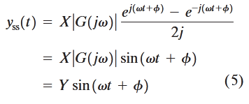
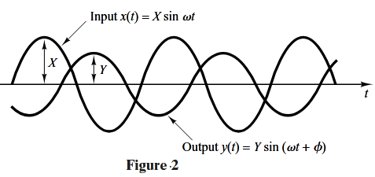
Frequency-Response Method
Obtaining Steady-State Outputs to Sinusoidal Inputs
Equation (4) can be written

Slide 14
Frequency-Response Method
Obtaining Steady-State Outputs to Sinusoidal Inputs
where $Y=X|G\left(jω\right)|$. We see that a stable, linear, time-invariant system subjected to a sinusoidal input will, at steady state, have a sinusoidal output of the same frequency as he input. But the amplitude and phase of the output will, in general, be different from those of the input. In fact, the amplitude of the output is given by the product of that of the input and $|G\left(jω\right)|$, while the phase angle differs from that of the input by the amount $∅=∠G\left(jω\right)$. An example of input and output sinusoidal signals is shown in Figure 2.
On the basis of this, we obtain this important result: For sinusoidal inputs,

Slide 15
Frequency-Response Method
Obtaining Steady-State Outputs to Sinusoidal Inputs
Hence, the steady-state response characteristics of a system to a sinusoidal input can be obtained directly from

Slide 16
Frequency-Response Method
Obtaining Steady-State Outputs to Sinusoidal Inputs
The function $G\left(jω\right)$ is called the sinusoidal transfer function. It is the ratio of $Y\left(jω\right)$ to $X\left(jω\right)$, is a complex quantity, and can be represented by the magnitude and phase angle with frequency as a parameter. The sinusoidal transfer function of any linear system is obtained by substituting $jω$ for s in the transfer function of the system.
EXAMPLE 1 Consider the system shown in Figure 3. The transfer function G(s) is
For the sinusoidal input $x\left(t\right)=Xsin ωt$, the steady-state output $y_{ss}\left(t\right)$ can be found as follows:
Substituting $jω$ for s in G(s) yields

Slide 17
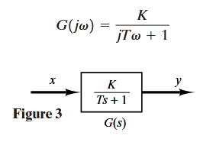
Frequency-Response Method
Obtaining Steady-State Outputs to Sinusoidal Inputs
The amplitude ratio of the output to the input is

Slide 18
Frequency-Response Method
Obtaining Steady-State Outputs to Sinusoidal Inputs
Thus, for the input $x\left(t\right)=Xsin ωt$, the steady-state output $y_{ss}\left(t\right)$ can be obtained from Equation (5) as follows:
From Equation (6), it can be seen that for small $ω$, the amplitude of the steady-state output $y_{ss}\left(t\right)$ is almost equal to K times the amplitude of the input. The phase shift of the output is small for small $ω$. For large $ω$, the amplitude of the output is small and almost inversely proportional to $ω$. The phase shift approaches –90° as $ω$ approaches infinity. This is a phase-lag network.

Slide 19
Frequency-Response Method
Polar Plots
The polar plot of a sinusoidal transfer function $G\left(jω\right)$ is a plot of the magnitude of $G\left(jω\right)$ versus the phase angle of $G\left(jω\right)$ on polar coordinates as $ω$ is varied from zero to infinity. Thus, the polar plot is the locus of vectors $\left|G\left(jω\right)\right|∠G\left(jω\right)$as $ω$ is varied from zero to infinity. Note that in polar plots a positive (negative) phase angle is measured counterclockwise (clockwise) from the positive real axis. The polar plot is often called the Nyquist plot. An example of such a plot is shown in Figure 25. Each point on the polar plot of $G\left(jω\right)$ represents the terminal point of a vector at a particular value of $ω$. In the polar plot, it is important to show the frequency graduation of the locus. The projections of $G\left(jω\right)$ on the real and imaginary axes are its real and imaginary components.

Slide 20
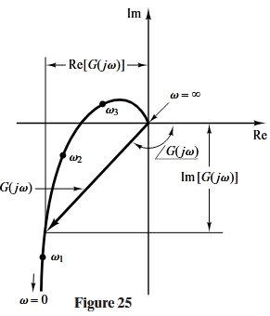
Frequency-Response Method
Polar Plots
An advantage in using a polar plot is that it depicts the frequency response characteristics of a system over the entire frequency range in a single plot. One disadvantage is that the plot does not clearly indicate the contributions of each individual factor of the open-loop transfer function.

Slide 21
Frequency-Response Method
Polar Plots
Integral and Derivative Factors ${(jω)}^{±1}$. The polar plot of $G\left(jω\right)=1/{jω}$ is the negative imaginary axis, since
The polar plot of $G\left(jω\right)=jω$ is the positive imaginary axis.
First-Order Factors ${(1+jωT)}^{±1}$. For the sinusoidal transfer function

Slide 22
Frequency-Response Method
Polar Plots
If $ω$ approaches infinity, the magnitude of $G\left(jω\right)$ approaches zero and the phase angle approaches –90°. The polar plot of this transfer function is a semicircle as the frequency $ω$ is varied from zero to infinity, as shown in Figure 26(a). The center is located at 0.5 on the real axis, and the radius is equal to 0.5.
To prove that the polar plot of the first-order factor $G\left(jω\right)=1/{(1+jωT)}$is a semicircle, define
$$G\left(jω\right)=X+jY$$

Slide 23
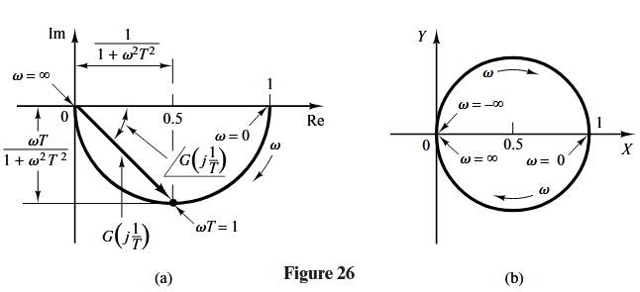
Frequency-Response Method
Polar Plots

Slide 24
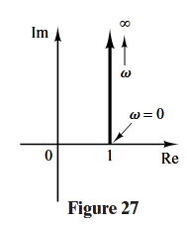
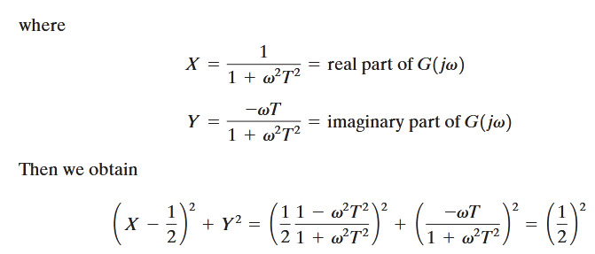
Frequency-Response Method
Polar Plots

Slide 25
Frequency-Response Method
Polar Plots
Thus, in the X-Y plane $G\left(jω\right)$ is a circle with center at $X=0.5,Y=0$ and with radius $0.5$ as shown in Figure 26(b). The lower semicircle corresponds to $0≤ω≤∞$, and the upper semicircle corresponds to $−∞≤ω≤0$.
The polar plot of the transfer function $1+jωT$ is simply the upper half of the straight line passing through point (1,0) in the complex plane and parallel to the imaginary axis, as shown in Figure 27. The polar plot of $1+jωT$ has an appearance completely different from that of $1/{1+jωT}$.

Slide 26
Frequency-Response Method
Polar Plots
Quadratic Factors. ${\left[1+2ζ\left({jω}/{ω_{n}}\right)+{({jω}/{ω_{n}})}^{2}\right]}^{±1}$The low- and high-frequency portions of the polar plot of the following sinusoidal transfer function
The polar plot of this sinusoidal transfer function starts at $1∠0^{ͦ}$ and ends at $0∠{180}^{ͦ}$as$ω$ increases from zero to infinity. Thus, the high-frequency portion of $G\left(jω\right)$ is tangent to the negative real axis.

Slide 27
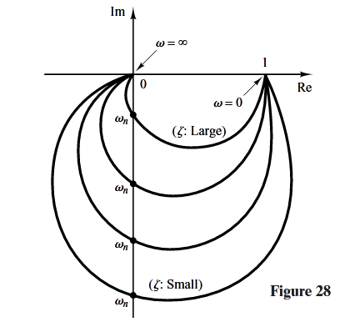
Frequency-Response Method
Polar Plots

Slide 28
Frequency-Response Method
Polar Plots
Examples of polar plots of the transfer function just considered are shown in Figure28. The exact shape of a polar plot depends on the value of the damping ratio $ζ$, but the general shape of the plot is the same for both the underdamped case ($1>ζ>0$) and overdamped case ($ζ>1$).
For the underdamped case at $ω=ω_{n}$ , we have $G\left(jω_{n}\right)=1/{(j2ζ)}$,and the phase angle at $ω=ω_{n}$ is –90°. Therefore, it can be seen that the frequency at which the $G\left(jω\right)$ locus intersects the imaginary axis is the undamped natural frequency $ω_{n}$ . In the polar plot, the frequency point whose distance from the origin is maximum cor-responds to the resonant frequency $ω_{r}$ . The peak value of $G\left(jω\right)$ is obtained as the ratio of the magnitude of the vector at the resonant frequency $ω_{r}$ to the magnitude of the vector at $ω=$0. The resonant frequency $ω_{r}$ is indicated in the polar plot shown in Figure 29.
Notes:
r

Slide 29
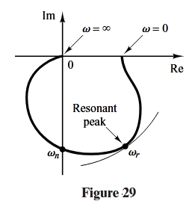
Frequency-Response Method
Polar Plots
For the overdamped case, as $ζ$ increases well beyond unity, the $G\left(jω\right)$ locus approaches a semicircle. This may be seen from the fact that, for a heavily damped system, the characteristic roots are real, and one is much smaller than the other. Since, for sufficiently large $ζ$, the effect of the larger root (larger in the absolute value) on the response becomes very small, the system behaves like a first-order one.
Notes:
r

Slide 30
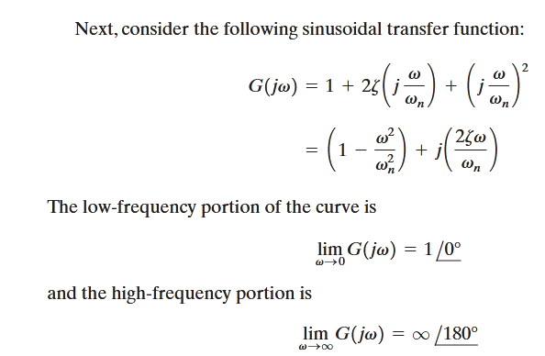
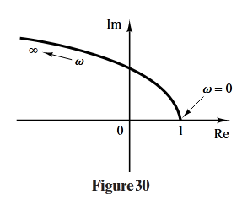
Frequency-Response Method
Polar Plots
Notes:
r

Slide 31
Frequency-Response Method
Polar Plots
Since the imaginary part of $G\left(jω\right)$ is positive for $ω>$0 and is monotonically increasing, and the real part of $G\left(jω\right)$ is monotonically decreasing from unity, the general shape of the polar plot of $G\left(jω\right)$ is as shown in Figure 30. The phase angle is between 0° and 180°.
EXAMPLE 8 Consider the following second-order transfer function:
Notes:
r

Slide 32
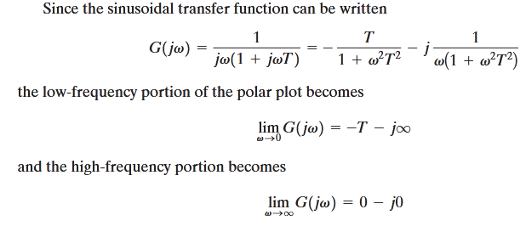
Frequency-Response Method
Polar Plots
Notes:
r

Slide 33
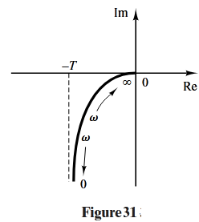
Frequency-Response Method
Polar Plots
The general shape of the polar plot of $G\left(jω\right)$ is shown in Figure 31. The $G\left(jω\right)$ plot is asymptotic to the vertical line passing through the point (–T, 0). Since this transfer function involves an integrator (1/s), the general shape of the polar plot differs substantially from those of second-order transfer functions that do not have an integrator.
Notes:
r

Slide 34
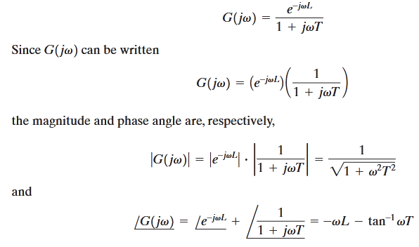
Frequency-Response Method
Polar Plots
EXAMPLE 9
Obtain the polar plot of the following transfer function:
Notes:
r

Slide 35
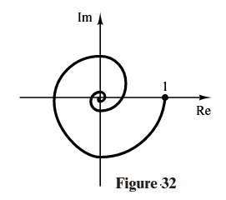
Frequency-Response Method
Polar Plots
EXAMPLE 9
Since the magnitude decreases from unity monotonically and the phase angle also decreases monotonically and indefinitely, the polar plot of the given transfer function is a spiral, as shown in Figure 32.
Notes:
r

Slide 36
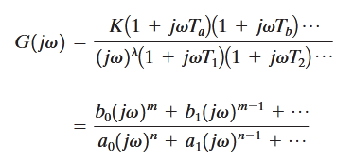
Frequency-Response Method
General Shapes of Polar Plots.
The polar plots of a transfer function of the form
where n>m or the degree of the denominator polynomial is greater than that of the numerator, will have the following general shapes:
Notes:
r

Slide 37
Frequency-Response Method
General Shapes of Polar Plots.
1- For $λ=$0 or type 0 systems: The starting point of the polar plot (which corresponds to $ω=0$) is finite and is on the positive real axis. The tangent to the polar plot at $ω=0$ is perpendicular to the real axis. The terminal point, which corresponds to $ω=∞$, is at the origin, and the curve is tangent to one of the axes.
2- For $λ=$1 or type 1 systems: the $jω$ term in the denominator contributes –90° to the total phase angle of $G\left(jω\right)$ for $0≤ω≤∞$. At $ω=0$, the magnitude of $G\left(jω\right)$ is infinity, and the phase angle becomes –90°. At low frequencies, the polar plot is asymptotic to a line parallel to the negative imaginary axis. At $ω=∞$, the magnitude becomes zero, and the curve converges to the origin and is tangent to one of the axes
Notes:
r

Slide 38
Frequency-Response Method
General Shapes of Polar Plots.
3- For $λ=$2 or type 2 systems: The ${\left(jω\right)}^{2}$ term in the denominator contributes –180° to the total phase angle of $G\left(jω\right)$ for $0≤ω≤∞$. At $ω=0$, the magnitude of $G\left(jω\right)$ is infinity, and the phase angle is equal to –180°. At low frequencies, the polar plot may be asymptotic to the negative real axis. At$ω=∞$, the magnitude becomes zero, and the curve is tangent to one of the axes.
The general shapes of the low-frequency portions of the polar plots of type 0, type 1, and type 2 systems are shown in Figure 33. It can be seen that, if the degree of the denominator polynomial of $G\left(jω\right)$ is greater than that of the numerator, then the $G\left(jω\right)$ loci converge to the origin clockwise. At $ω=∞$, the loci are tangent to one or the other axes, as shown in Figure 34.
Notes:
r

Slide 39
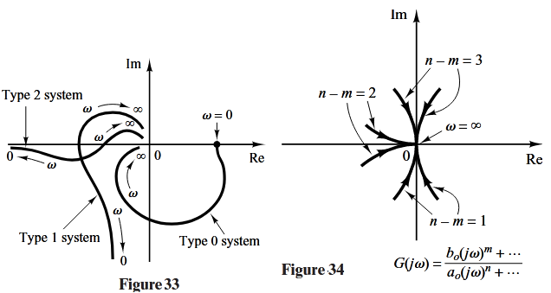
Frequency-Response Method
General Shapes of Polar Plots.
Notes:
r

Slide 40
Frequency-Response Method
General Shapes of Polar Plots.
Note that any complicated shapes in the polar plot curves are caused by the numerator dynamics—that is, by the time constants in the numerator of the transfer function. Figure 35 shows examples of polar plots of transfer functions with numerator dynamics. In analyzing control systems, the polar plot of $G\left(jω\right)$ in the frequency range of interest must be accurately determined.
Table 1 shows sketches of polar plots of several transfer functions.
Notes:
r

Slide 41
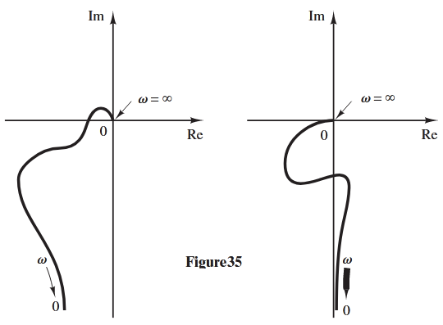
Frequency-Response Method
General Shapes of Polar Plots.
Notes:
r

Slide 42
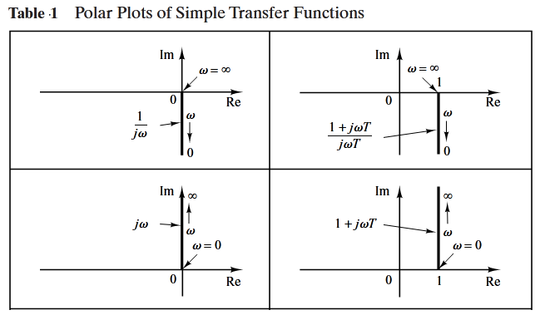
Frequency-Response Method
General Shapes of Polar Plots.
Notes:
r

Slide 43
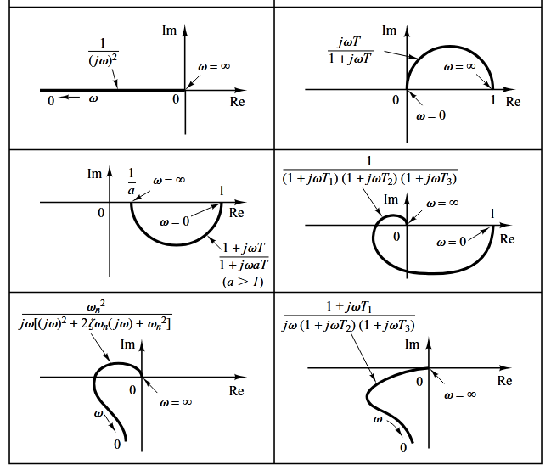
Frequency-Response Method
General Shapes of Polar Plots.
Notes:
r

Slide 44
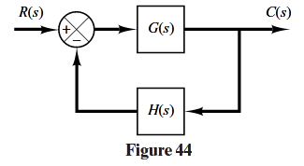
Frequency-Response Method
Nyquist Stability Criterion
The Nyquist stability criterion determines the stability of a closed-loop system from its open-loop frequency response and open-loop poles.
This section presents mathematical background for understanding the Nyquist stability criterion. Consider the closed-loop system shown in Figure 44. The closed-loop transfer function is
Notes:
r

Slide 45
Frequency-Response Method
Nyquist Stability Criterion
For stability, all roots of the characteristic equation
must lie in the left-half s plane. [It is noted that, although poles and zeros of the open-loop transfer function G(s)H(s) may be in the right-half s plane, the system is stable if all the poles of the closed-loop transfer function (that is, the roots of the characteristic equation) are in the left-half s plane.] The Nyquist stability criterion relates the open-loop frequency response $G\left(jω\right)H\left(jω\right)$ to the number of zeros and poles of 1+G(s)H(s) that lie in the right-half s plane.
Notes:
r

Slide 46
Frequency-Response Method
Nyquist Stability Criterion
This criterion, derived by H. Nyquist, is useful in control engineering because the absolute stability of the closed-loop system can be determined graphically from open-loop frequency-response curves, and there is no need for actually determining the closed-loop poles. Analytically obtained open-loop frequency-response curves, as well as those experimentally obtained, can be used for the stability analysis. This is convenient because, in designing a control system, it often happens that mathematical expressions for some of the components are not known; only their frequency-response data are available.
Notes:
r

Slide 47
Frequency-Response Method
Nyquist Stability Criterion
The Nyquist stability criterion is based on a theorem from the theory of complex variables. To understand the criterion, we shall first discuss mappings of contours in the complex plane.
We shall assume that the open-loop transfer function G(s)H(s) is representable as a ratio of polynomials in s. For a physically realizable system, the degree of the denominator polynomial of the closed-loop transfer function must be greater than or equal to that of the numerator polynomial. This means that the limit of G(s)H(s) as s approaches infinity is zero or a constant for any physically realizable system.
Notes:
r

Slide 48
Frequency-Response Method
Nyquist Stability Criterion
Mapping Theorem.
Let F(s) be a ratio of two polynomials in s. Let P be the number of poles and Z be the number of zeros of F(s) that lie inside some closed contour in the s plane, with multiplicity of poles and zeros accounted for. Let the contour be such that it does not pass through any poles or zeros of F(s).This closed contour in the s plane is then mapped into the F(s) plane as a closed curve. The total number N of clockwise encirclements of the origin of the F(s) plane, as a representative point s traces out the entire contour in the clockwise direction, is equal to Z-P. (Note that by this mapping theorem, the numbers of zeros and of poles cannot be found—only their difference.)
Notes:
r

Slide 49
Frequency-Response Method
Nyquist Stability Criterion
Mapping Theorem.
Note that a positive number N indicates an excess of zeros over poles of the function F(s) and a negative N indicates an excess of poles over zeros. In control system applications, the number P can be readily determined for F(s)=1+G(s)H(s) from the function G(s)H(s). Therefore, if N is determined from the plot of F(s), the number of zeros in the closed contour in the s plane can be determined readily. Note that the exact shapes of the s-plane contour and F(s) locus are immaterial so far as encirclements of the origin are concerned, since encirclements depend only on the enclosure of poles and/or zeros of F(s) by the s-plane contour.
Notes:
r

Slide 50
Frequency-Response Method
Nyquist Stability Criterion
Application of the Mapping Theorem to the Stability Analysis of Closed-Loop
Systems.
For analyzing the stability of linear control systems, we let the closed contour in the s plane enclose the entire right-half s plane. The contour consists of the entire $jω$axis from $ω=−∞ to+∞$ and a semicircular path of infinite radius in the right-half s plane. Such a contour is called the Nyquist path. (The direction of the path is clockwise.) The Nyquist path encloses the entire right-half s plane and encloses all the zeros and poles of 1+G(s)H(s) that have positive real parts. [If there are no zeros of 1+G(s)H(s) in the right-half s plane, then there are no closed-loop poles there, and the system is stable.] It is necessary that the closed contour, or the Nyquist path, not pass through any zeros and poles of 1+G(s)H(s). If G(s)H(s) has a pole or poles at the origin of the s plane, mapping of the point s=0 becomes indeterminate. In such cases, the origin is avoided by taking a detour around it.
Notes:
r

Slide 51
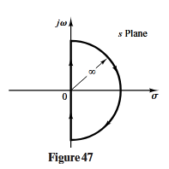
Frequency-Response Method
Nyquist Stability Criterion
Application of the Mapping Theorem to the Stability Analysis of Closed-Loop
Systems.
If the mapping theorem is applied to the special case in which F(s) is equal to 1+G(s)H(s), then we can make the following statement: If the closed contour in the s plane encloses the entire right-half s plane, as shown in Figure 47, then the number of right-half plane zeros of the function F(s)=1+G(s)H(s) is equal to the number of poles of the function F(s)=1+G(s)H(s) in the right-half s plane plus the number of clockwise encirclements of the origin of the 1+G(s)H(s) plane by the corresponding closed curve in this latter plane.
Notes:
r

Slide 52
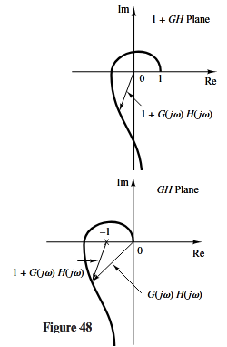
Frequency-Response Method
Nyquist Stability Criterion
Application of the Mapping Theorem to the Stability Analysis of Closed-Loop Systems.
Because of the assumed condition that
the function of 1+G(s)H(s) remains constant as s traverses the semicircle of infinite radius. Because of this, whether the locus of 1+G(s)H(s) encircles the origin of the 1+G(s)H(s) plane can be determined by considering only a part of the closed contour in the s plane—that is, the $jω$ axis. Encirclements of the origin, if there are any, occur only while a representative point moves from $−j∞ to+j∞$along the $jω$axis, provided that no zeros or poles lie on the $jω$ axis.
Notes:
r

Slide 53
Frequency-Response Method
Nyquist Stability Criterion
Application of the Mapping Theorem to the Stability Analysis of Closed-Loop Systems.
Note that the portion of the 1+G(s)H(s) contour from $ω=−∞ to+∞$ is simply $1+G\left(jω\right)H\left(jω\right)$. Since $1+G\left(jω\right)H\left(jω\right)$ is the vector sum of the unit vector and the vector $G\left(jω\right)H\left(jω\right)$, $1+G\left(jω\right)H\left(jω\right)$ is identical to the vector drawn from the –1+j0 point to the terminal point of the vector $G\left(jω\right)H\left(jω\right)$, as shown in Figure 48.
Encirclement of the origin by the graph of $1+G\left(jω\right)H\left(jω\right)$ is equivalent to encirclement of the –1+j0 point by just the $G\left(jω\right)H\left(jω\right)$ locus. Thus, the stability of a closed-loop system can be investigated by examining encirclements of the –1+j0 point by the locus of $G\left(jω\right)H\left(jω\right)$. The number of clockwise encirclements of the –1+j0 point can be found by drawing a vector from the –1+j0 point to the $G\left(jω\right)H\left(jω\right)$ locus, starting from $ω=−∞$, going through $ω=0$, and ending at $ω=+∞$, and by counting the number of clockwise rotations of the vector.

Slide 54
Frequency-Response Method
Nyquist Stability Criterion
Application of the Mapping Theorem to the Stability Analysis of Closed-Loop Systems.
Plotting $G\left(jω\right)H\left(jω\right)$ for the Nyquist path is straightforward. The map of the negative $jω$ axis is the mirror image about the real axis of the map of the positive $jω$ axis. That is, the plot of $G\left(jω\right)H\left(jω\right)$ and the plot of $G\left(−jω\right)H\left(−jω\right)$) are symmetrical with each other about the real axis. The semicircle with infinite radius maps into either the origin of the GH plane or a point on the real axis of the GH plane.
In the preceding discussion, G(s)H(s) has been assumed to be the ratio of two polynomials in s. Thus, the transport lag $e^{−Ts}$ has been excluded from the discussion. Note, however, that a similar discussion applies to systems with transport lag, although a proof of this is not given here. The stability of a system with transport lag can be determined from the open-loop frequency-response curves by examining the number of encirclements of the –1+j0 point, just as in the case of a system whose open-loop transfer function is a ratio of two polynomials in s.

Slide 55
Frequency-Response Method
Nyquist Stability Criterion
The foregoing analysis, utilizing the encirclement of the –1+j0 point by the $G\left(jω\right)H\left(jω\right)$ locus, is summarized in the following Nyquist stability criterion:
Nyquist stability criterion [ for a special case when G(s)H(s) has neither poles nor zeros on the $jω$ axis]: In the system shown in Figure 44, if the open-loop transfer function G(s)H(s) has k poles in the right-half s plane and $\lim_{s→∞}{G\left(s\right)H\left(s\right)=constant, }$then for stability, the $G\left(jω\right)H\left(jω\right)$ locus, as $ω$ varies from $−∞ to+∞$, must encircle the –1+j0 point k times in the counterclockwise direction.

Slide 56
Frequency-Response Method
Remarks on the Nyquist Stability Criterion
1. This criterion can be expressed as where number of zeros of 1+G(s)H(s) in the right-half s plane number of clockwise encirclements of the –1+j0 point number of poles of G(s)H(s) in the right-half s plane If P is not zero, for a stable control system, we must have Z=0, or N=–P, which means that we must have P counterclockwise encirclements of the –1+j0 point.
If G(s)H(s) does not have any poles in the right-half s plane, then Z=N.
Thus, for stability there must be no encirclement of the –1+j0 point by the $G\left(jω\right)H\left(jω\right)$ locus. In this case it is not necessary to consider the locus for the entire $jω$ axis, only for the positive-frequency portion. The stability of such a system can be determined by seeing if the –1+j0 point is enclosed by the Nyquist plot of $G\left(jω\right)H\left(jω\right)$. The region enclosed by the Nyquist plot is shown in Figure 49.
For stability, the –1+j0 point must lie outside the shaded region.

Slide 57
Frequency-Response Method
Remarks on the Nyquist Stability Criterion
2. We must be careful when testing the stability of multiple-loop systems since they may include poles in the right-half s plane. (Note that although an inner loop may be unstable, the entire closed-loop system can be made stable by proper design.)
Simple inspection of encirclements of the –1+j0 point by the $G\left(jω\right)H\left(jω\right)$ locus is not sufficient to detect instability in multiple-loop systems. In such cases, however, whether any pole of 1+G(s)H(s) is in the right-half s plane can be determined easily by applying the Routh stability criterion to the denominator of G(s)H(s).
If transcendental functions, such as transport lag $e^{−Ts}$, are included in G(s)H(s), they must be approximated by a series expansion before the Routh stability criterion can be applied.

Slide 58
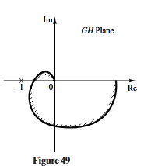
Frequency-Response Method
Remarks on the Nyquist Stability Criterion
3. If the locus of $G\left(jω\right)H\left(jω\right)$ passes through the
–1+j0 point, then zeros of the characteristic equation, or closed-loop poles, are located on the $jω$ axis. This is not desirable for practical control systems. For a well-designed closed-loop system, none of the roots of the characteristic equation should lie on the $jω$ axis.

Slide 59
Frequency-Response Method
Special Case when G(s)H(s) Involves Poles and/or Zeros on the $jω$ Axis.
the previous discussion, we assumed that the open-loop transfer function G(s)H(s) has neither poles nor zeros at the origin. We now consider the case where G(s)H(s) involves poles and/or zeros on the $jω$ axis.
Since the Nyquist path must not pass through poles or zeros of G(s)H(s), if the function G(s)H(s) has poles or zeros at the origin (or on the $jω$ axis at points other than the origin), the contour in the s plane must be modified. The usual way of modifying the contour near the origin is to use a semicircle with the infinitesimal radius $ε$, as shown in Figure 50. [Note that this semicircle may lie in the right-half s plane or in the left-half s plane. Here we take the semicircle in the right-half s plane.]

Slide 60
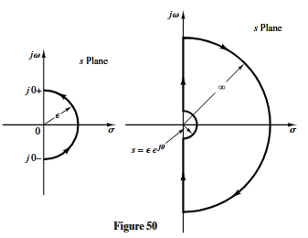
Frequency-Response Method
Special Case when G(s)H(s) Involves Poles and/or Zeros on the $jω$ Axis.

Slide 61
Frequency-Response Method
Special Case when G(s)H(s) Involves Poles and/or Zeros on the $jω$ Axis.
A representative point s moves along the negative $jω$ axis from $−j∞ to j$0+. From $s=j0− to j0+$ , the point moves along the semicircle of radius $ε$ (where $ε≪1$) and then moves along the positive $jω$ axis from $j0$+ to $j∞$. From $s=j∞$, the contour follows a semicircle with infinite radius, and the representative point moves back to the starting point, $s=−j∞$. The area that the modified closed contour avoids is very small and approaches zero as the radius $ε$ approaches zero. Therefore, all the poles and zeros, if any, in the right-half s plane are enclosed by this contour.

Slide 62
Frequency-Response Method
Special Case when G(s)H(s) Involves Poles and/or Zeros on the $jω$ Axis.
Consider, for example, a closed-loop system whose open-loop transfer function is given by
The points corresponding to $j0+$ and $j0−$on the locus of G(s)H(s) in the G(s)H(s) plane are $−j∞ and +j∞$ respectively. On the semicircular path with radius $ε$ (where $ε≪1$), the complex variable s can be written
$${s=εe}^{jθ}$$
where $θ$ varies from –90° to +90°. Then G(s)H(s) becomes

Slide 63
Frequency-Response Method
Special Case when G(s)H(s) Involves Poles and/or Zeros on the $jω$ Axis.
The value $K/ε$ approaches infinity as $ε$ approaches zero, and $θ$ varies from –90° to +90° as a representative point s moves along the semicircle in the s plane. Thus, the points $G\left(j0−\right)H\left(j0−\right)=j∞$and $G\left(j0+\right)H\left(j0+\right)=−j∞$are joined by a semicircle of infinite radius in the right-half GH plane. The infinitesimal semicircular detour around the origin in the s plane maps into the GH plane as a semicircle of infinite radius. Figure 51 shows the s-plane contour and the G(s)H(s) locus in the GH plane. Points A, B, and C on the s-plane contour map into the respective points Á,B´, and Ć on the G(s)H(s) locus.

Slide 64
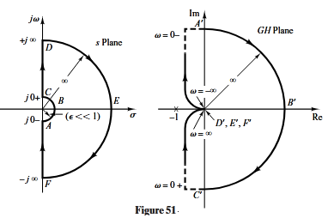
Frequency-Response Method
Special Case when G(s)H(s) Involves Poles and/or Zeros on the $jω$ Axis.

Slide 65
Frequency-Response Method
Special Case when G(s)H(s) Involves Poles and/or Zeros on the $jω$ Axis.
As seen from Figure 51, points D, E, and F on the semicircle of infinite radius in the s plane map into the origin of the GH plane. Since there is no pole in the right half s plane and the G(s)H(s) locus does not encircle the –1+j0 point, there are no zeros of the function 1+G(s)H(s) in the right-half s plane. Therefore, the system is stable.
For an open-loop transfer function G(s)H(s) involving a $1/{s^{n}}$ factor (where n=2, 3, p ), the plot of G(s)H(s) has n clockwise semicircles of infinite radius about the origin as a representative point s moves along the semicircle of radius $ε$ (where $ε≪1$). For example, consider the following open-loop transfer function:

Slide 66
Frequency-Response Method
Special Case when G(s)H(s) Involves Poles and/or Zeros on the $jω$ Axis.
As $θ$ varies from –90° to 90° in the s plane, the angle of G(s)H(s) varies from 180° to –180°, as shown in Figure 52. Since there is no pole in the right-half s plane and the locus encircles the –1+j0 point twice clockwise for any positive value of K, there are two zeros of 1+G(s)H(s) in the right-half s plane. Therefore, this system is always unstable.

Slide 67
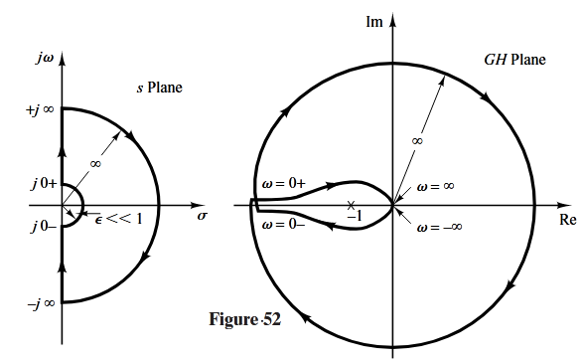
Frequency-Response Method
Special Case when G(s)H(s) Involves Poles and/or Zeros on the $jω$ Axis.

Slide 68
Frequency-Response Method
Special Case when G(s)H(s) Involves Poles and/or Zeros on the $jω$ Axis.
Note that a similar analysis can be made if G(s)H(s) involves poles and/or zeros on the $jω$ axis. The Nyquist stability criterion can now be generalized as follows:
Nyquist stability criterion [for a general case when G(s)H(s) has poles and/or zeros on the $jω$ axis]: In the system shown in Figure 44, if the open-loop transfer function G(s)H(s) has k poles in the right-half s plane, then for stability the G(s)H(s) locus, as a representative point s traces on the modified Nyquist path in the clockwise direction, must encircle the –1+j0 point k times in the counterclockwise direction.

Slide 69
Frequency-Response Method
Stability Analysis
If the Nyquist path in the s plane encircles Z zeros and P poles of 1+G(s)H(s) and does not pass through any poles or zeros of 1+G(s)H(s) as a representative point s moves in the clockwise direction along the Nyquist path, then the corresponding contour in the G(s)H(s) plane encircles the –1+j0 point N=Z-P times in the clockwise direction. (Negative values of N imply counterclockwise encirclements.)
In examining the stability of linear control systems using the Nyquist stability criterion, we see that three possibilities can occur:

Slide 70
Frequency-Response Method
Stability Analysis
1. There is no encirclement of the –1+j0 point. This implies that the system is stable if there are no poles of G(s)H(s) in the right-half s plane; otherwise, the system is unstable.
2. There are one or more counterclockwise encirclements of the –1+j0 point. In this case the system is stable if the number of counterclockwise encirclements is the same as the number of poles of G(s)H(s) in the right-half s plane; otherwise, the system is unstable.
3. There are one or more clockwise encirclements of the –1+j0 point. In this case the system is unstable.

Slide 71
Frequency-Response Method
Stability Analysis
EXAMPLE 14 Consider a closed-loop system whose open-loop transfer function is given by
Examine the stability of the system.

Slide 72
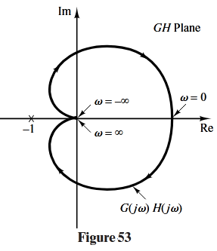
Frequency-Response Method
Stability Analysis
A plot of $G\left(jω\right)H\left(jω\right)$ is shown in Figure 53. Since G(s)H(s) does not have any poles in the right-half s plane and the –1+j0 point is not encircled by the $G\left(jω\right)H\left(jω\right)$ locus, this system is stable for any positive values of K, T1 and T2 .

Slide 73
Frequency-Response Method
Stability Analysis
EXAMPLE 15
Consider the system with the following open-loop transfer function:
Determine the stability of the system for two cases: (1) the gain K is small and (2) K is large.
The Nyquist plots of the open-loop transfer function with a small value of K and a large value of K are shown in Figure 54. The number of poles of G(s)H(s) in the right-half s plane is zero.

Slide 74
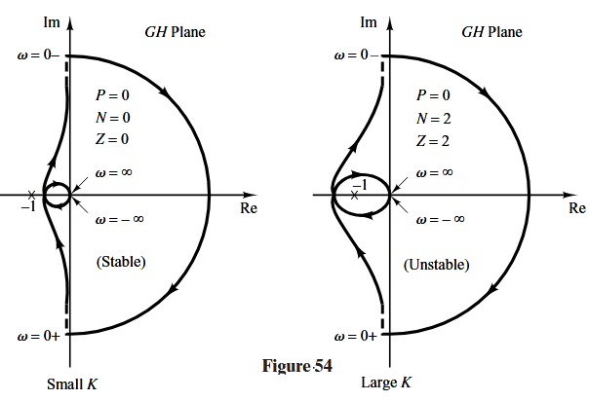
Frequency-Response Method
Stability Analysis
EXAMPLE 15

Slide 75
Frequency-Response Method
Stability Analysis
EXAMPLE 15
Therefore, for this system to be stable, it is necessary that N=Z=0 or that the G(s)H(s) locus not encircle the –1+j0 point.
For small values of K, there is no encirclement of the –1+j0 point. Hence, the system is stable for small values of K. For large values of K, the locus of G(s)H(s) encircles the –1+j0 point twice in the clockwise direction, indicating two closed-loop poles in the right-half s plane, and the system is unstable. (For good accuracy, K should be large. From the stability viewpoint, however, a large value of K causes poor stability or even instability.

Slide 76
Frequency-Response Method
Stability Analysis
EXAMPLE 16
The stability of a closed-loop system with the following open-loop transfer function
depends on the relative magnitudes of and Draw Nyquist plots and determine the stability of the system.
Plots of the locus G(s)H(s) for three cases, and are shown in Figure 55. For the locus of G(s)H(s) does not encircle the –1+j0 point, and the closed-loop system is stable. For , the G(s)H(s) locus passes through the –1+j0 point, which indicates that the closed-loop poles are located on the $jω$ axis. For the locus of G(s)H(s) encircles the –1+j0 point twice in the clockwise direction.
Thus, the closed-loop system has two closed-loop poles in the right-half s plane, and the system is unstable.

Slide 77
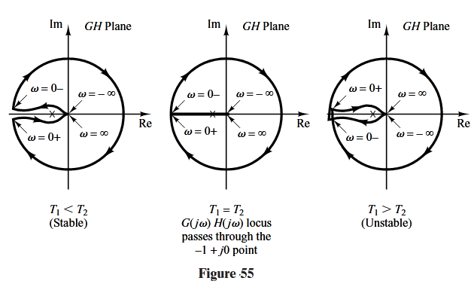
Frequency-Response Method
Stability Analysis
EXAMPLE 16

Slide 78
Frequency-Response Method
Stability Analysis
EXAMPLE 17
Consider the closed-loop system having the following open-loop transfer function:
Determine the stability of the system.

Slide 79
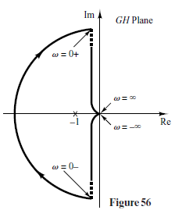
Frequency-Response Method
Stability Analysis
EXAMPLE 17
The function G(s)H(s) has one pole (s=1/T) in the right-half s plane. Therefore, P=1.The Nyquist plot shown in Figure 56 indicates that the G(s)H(s) plot encircles the –1+j0 point once clockwise. Thus, N=1. Since Z=N+P, we find that Z=2.This means that the closed loop system has two closed-loop poles in the right-half s plane and is unstable

Slide 80
Frequency-Response Method
Stability Analysis
EXAMPLE 18
Investigate the stability of a closed-loop system with the following open-loop transfer function:
The open-loop transfer function has one pole (s=1) in the right-half s plane, or P=1.The open-loop system is unstable. The Nyquist plot shown in Figure 57 indicates that the –1+j0 point is encircled by the G(s)H(s) locus once in the counterclockwise direction. Therefore, N=–1. Thus, Z is found from Z=N+P to be zero, which indicates that there is no zero of 1+G(s)H(s) in the right-half s plane, and the closed-loop system is stable. This is one of the examples for which an unstable open-loop system becomes stable when the loop is closed.

Slide 81
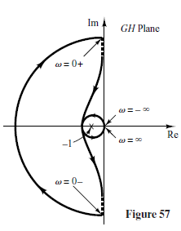
Frequency-Response Method
Stability Analysis
EXAMPLE 18

Slide 82
