Slide 1
1.Pediatric Dentistry 2. Endodontics
Dr. Lama Hammoud

Slide 2
Scope of Pediatric Dentistry:
Pediatric dentistry is one of the nine recognized specialties of the American Dental Association and is concerned with the care of the teeth and oral tissues of the child patient, from infancy through adolescence. The dentist specializing in this practice is called a pedodontist and has completed dental school with an additional two years of concentrated training in the psychology, management, growth development, health issues, and sedation of the child patient.
The first set of teeth to erupt is called the primary dentition. This combination consists of 20 deciduous teeth, which will be replaced by secondary or permanent teeth, plus 12 more adult teeth. The dental treatment and care given in pediatric dentistry is essentially the same as for adults, although instruments and some techniques may be modified

Slide 3
Development and Growth Concerns of the Pediatric Dentition:
Many of the dental problems of the child patient are the result of improper or irregular development of newly erupting teeth. Some congenital problems occur during the growth period in utero and are evident at birth or later when the teeth erupt, and others can happen when environment and habits affect the teeth.

Slide 4
Congenital or developmental problems may be:
ectopic arrangement: a disturbance in the eruption pattern; tooth erupts out of place.
anodontia: absence of teeth, usually of genetic origin.
macrodontia : abnormally large teeth.
cleft palate or lip: fissure of an organ; incomplete juncture.
hyperdontia : excess number of supernumerary teeth.
hypodontia : congenital absence of teeth.

Slide 5
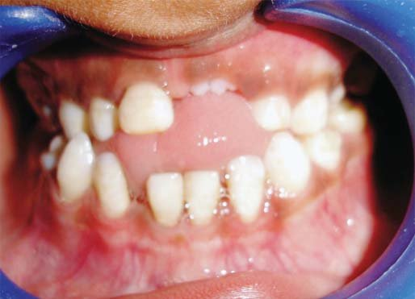
enamel hypoplasia: underdevelopment of the enamel tissue..
amelogenesis imperfecta : incomplete or improper development of the enamel tissue.
dentinogenesis imperfecta: incomplete or improper development of dentin tissue
aplasia :failure of an organ or body part to develop.

Slide 6
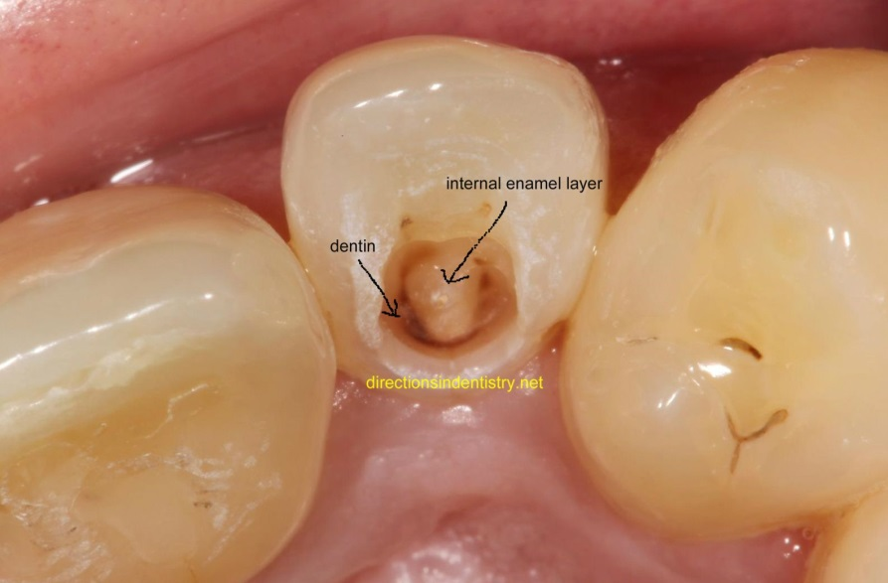
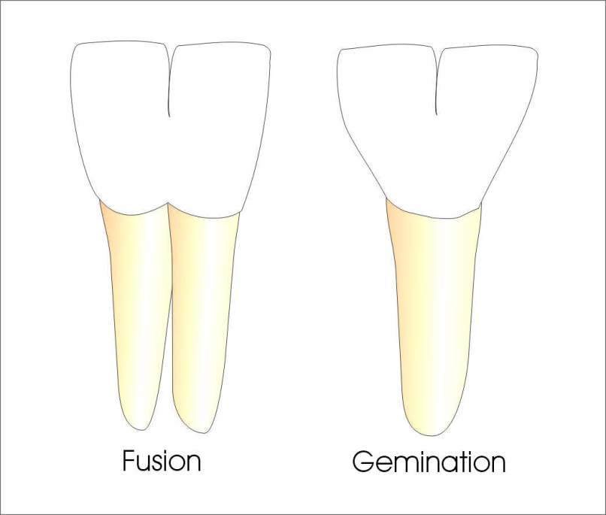
dens in dente: tooth within a tooth
germinated : attempted division of a single tooth.
fusion of teeth: union of two independently developing primary or secondary teeth.

Slide 7
Environmental or occurring problems can include the following:
caries: dental decay; the number one disease of children.
abscess: local collection of pus .
cellulitis: inflammation in the cellular or connective tissue.
early tooth exfoliation (shedding or falling off ): tooth loss resulting in the shifting of teeth and loss of tooth position.
ankylosis : stiff joint, retention of deciduous tooth.

Slide 8
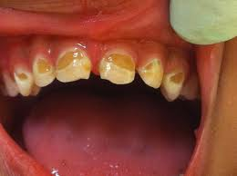
intrinsic (on the inside): internal discoloration of teeth resulting from diet, medication, or excessive fluoride during tooth development.
baby bottle mouth: mouth condition of badly decayed and rotted teeth with accompanying gum-tissue soreness that is caused from prolonged access to bottle feeding through sleep and eating.

Slide 9
Some growth irregularities and mouth-affecting habits present future problems requiring interceptive or orthodontic care. Occasionally, a baby is born with a tooth present, called a natal tooth. Teeth erupting in the first month are termed neonatal teeth. Because of lack of stability, inability to nurse, or other reasons, these teeth may be removed. Other maladies include open bite, diastemia (space gap), crossbites, tooth protrusions, oral habits such as thumb-sucking or lip sucking, and tooth crowding. Trauma and accidents, such as electric cord burn of lips and mouth tissues, require the attention of the pedodontist.

Slide 10
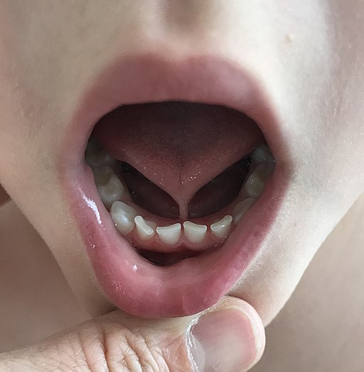
Not only are the developing teeth affected by growth problems, but sometimes the oral tissues and the child’s bones may develop problems associated with dental care, such as the following:
macroglossia (= large, glossia = tongue): enlarged tongue.
ankyloglossia : abnormally short lingual frenum causing limited tongue movement (tongue tied).

Slide 11
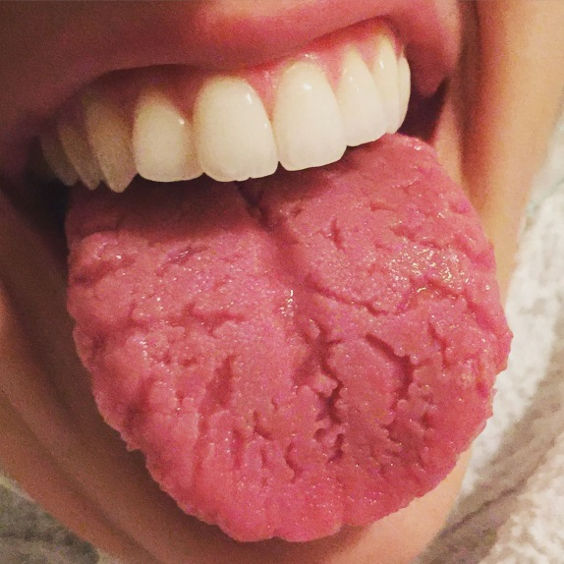
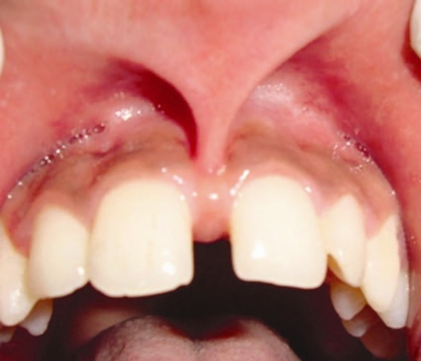
fissured tongue: grooved division, cleft, or split of tongue.
abnormal labial frenum: enlarged or thick labial frenum that may cause diastema, an open area between the central incisors.

Slide 12
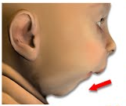
micrognathia : abnormally small jaw; undersized mandible.
cherubism : a genetic disorder resulting in enlargement of the cheek and other facial structures.

Slide 13
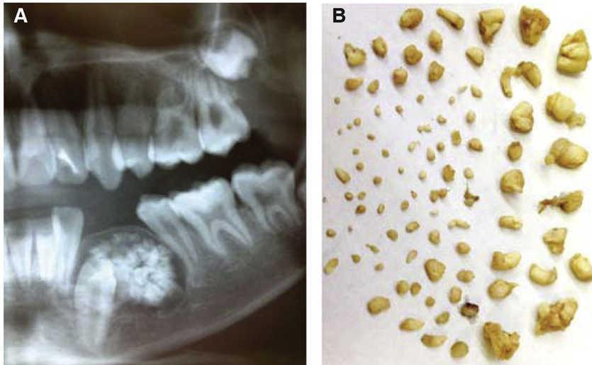
Tumor and Cyst Growth:
Some children develop neoplasms (new growths) of the oral soft tissue and bones. Related terms are:
papilloma: neoplasm arising from epithelial cells; benign tumor.
verruca vulgaris (= oral warts): viral cause, possibly from finger sucking.
odontoma (tumor of a tooth or dental tissue): abnormal cell proliferation.

Slide 14
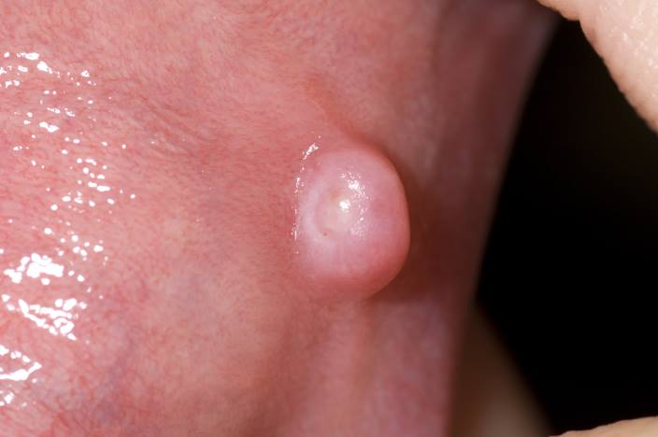
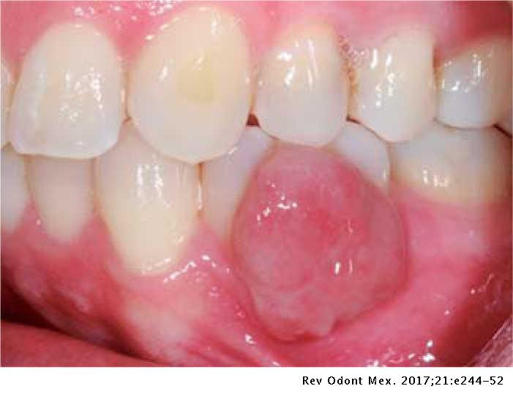
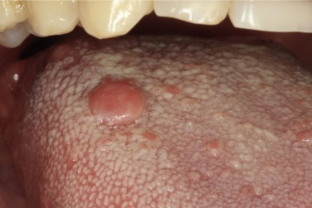
fibroma: fibrous tumor, benign in nature.
granuloma: grandular tumor usually of epithelioid or lymphoid cells.
neurofibromatosis : tumor on peripheral nerves.

Slide 15
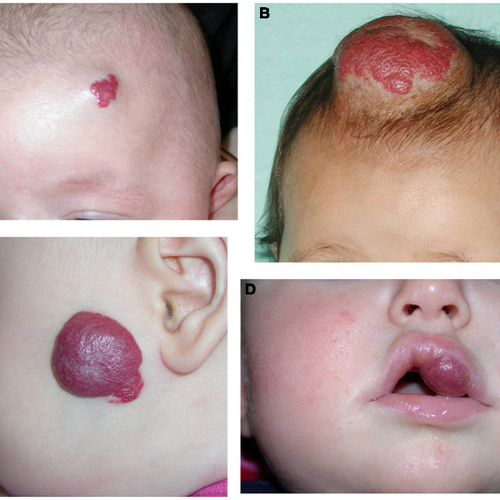
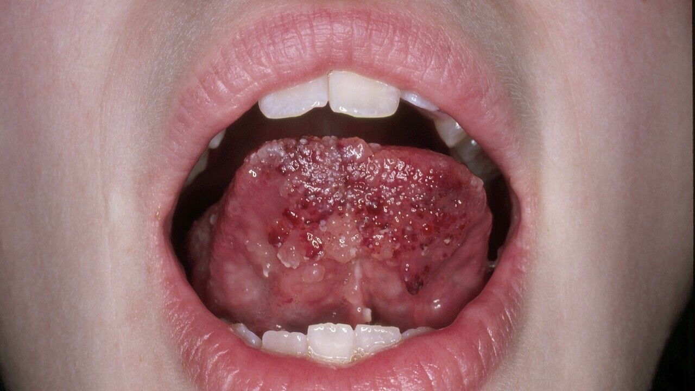
hemangioma: vascular tumor, generally located in the neck/head area.
lymphangioma : tumor made up of lymphatic vessels.
lymphoma : new tissue growth within the lymphatic system.

Slide 16
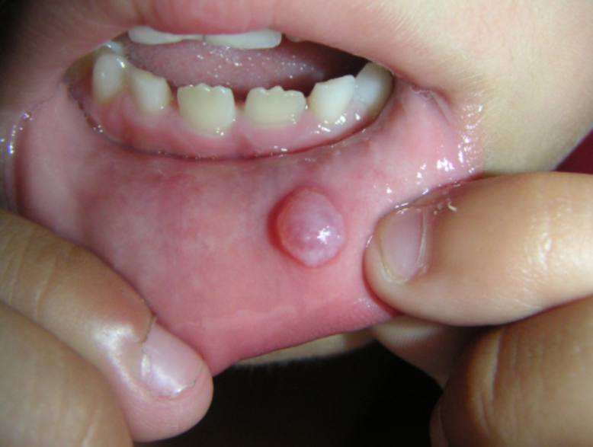
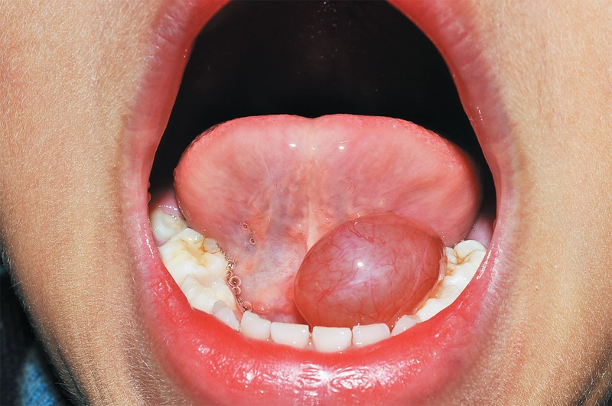
mucocele : mucous cyst.
ranula: mucocele in the floor of the mouth in the sublingual duct.

Slide 17
Maintenance and Preservation of the Pediatric Dentition:
Maintenance and preservation of the primary dentition involves the same care and attention as that given to adult teeth. Visits to the dentist should begin around the child’s first birthday and consist of the health and dental history, clinical and dental exam, prophylaxis, photos, and radiographs that have been modified in size for the smaller mouth. Parents may benefit from receiving instruction in nutrition and home care, including tooth brushing and other preventive measures at this time. Prophylaxis treatment may include gingival care for simple, eruption, scorbutic (lacking vitamin C ), or acute gingivitis, as well as periodontitis and periodontosis, herpes simplex virus, aphthous ulcer, ANUG, or candidiasis (fungus infection, thrush).
Appliances may be constructed to correct bad habits, such as finger sucking or nail-biting. Other professional preventive care is discussed in the following sections.

Slide 18
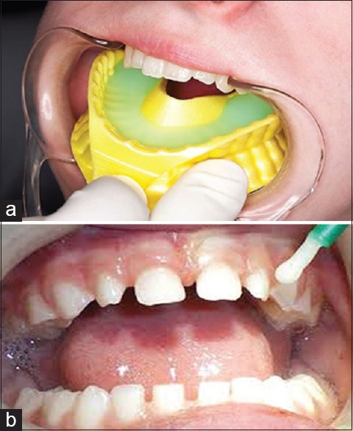
Fluoride Application:
The dentist may indicate a need for professional application of fluoride to the child’s teeth. Fluoride care may be provided in the form of ingestion by drinking water with fluoride or taking prescribed fluoride supplements by topical application, placing upon the teeth, or a combination of both techniques. Topical application is supplied in the form of gel, varnish, liquid, spray, or other methods

Slide 19
Enamoplasty:
Enamoplasty is the selective reduction of fissures and occlusal irregularities caused by grinding. Rather than filling deep pits or fissures with sealant material, the dentist may choose to perform some selective reducing or leveling of deep crevices to permit easier cleansing and home care of the teeth.

Slide 20
Pit and Fissure Sealant Application:
At the age of six or seven years and thereafter as the permanent teeth erupt, the occlusal surfaces are covered with a sealant: a clear or tinted acrylic coating that is either:
self-cured (when mixed, base and catalyst are chemically polymerized)
or light cured (polymerizes with the use of a curing light).
Application to the enamel surface requires prophylaxis, isolation, and then acid etching of the tooth before placement of the topical sealant. When in place and hardened, the sealant will from an even, hard acrylic coating on the chewing surfaces, eliminating any deep pits or fissures.

Slide 21
Oral Surgery:
Surgical intervention may be used to prevent future problems for developing teeth. Examples include extraction to remove ankylosed fixed, stiff ) teeth or a large labial frenum that requires a frenectomy (incision and suturing of frenum to the periosteum) to avoid a diastema of the anterior central incisors or surgery of the lingual frenum to avoid a tongue-tied condition.

Slide 22
Space Maintenance:
Professional care may involve placement of fixed or removable appliances to maintain or reclaim premature spacing in the arch until eruption of the secondary teeth. Some common space maintainers are the band and loop and the distal shoe appliances An acrylic bite plane appliance may be constructed to correct a simple crossbite, or the child may be fitted for a device to combat bad habits, such as thumb-sucking, nail-biting, or lip sucking.

Slide 23
Restorative Dental Care for the Primary Dentition:
Restorative care of the deciduous teeth is basically the same as for the permanent dentition. Restorations are completed in the same manner, but some instruments can be modified in size, such as a T-band matrix in place of a larger adult matrix and retainer. A T-band matrix may be curved or straight. These bands are bent into a circle, and the T edges are folded over to hold the shape. The strips require no retainer and take less space in a smaller mouth.
Small cavities may be excised using a laser beam, small curette, and acid solution to eliminate impurities and then refilled with amalgam or a composite material. Larger decay areas are treated in the same manner as adults. Badly decayed or broken down teeth may need to receive a straight edge or contoured stainless steel crown. The crown is fitted, or festooned (trimmed), and cemented onto the tooth. The child patient may receive composite resin bonding for tooth surfaces, ceramic and metal crowns, cores, fixed or removable partial or full dentures, implants, retainers, and protective mouth guards.

Slide 24
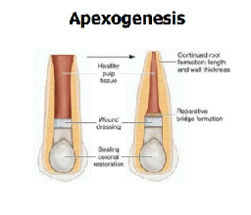
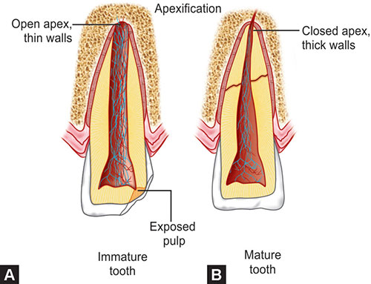
Pulpal Treatment:
Because of the large opening in the apex of the erupting and developing tooth, pulpal treatment may be more aggressive in the child. The two types of pulpal treatment are:
apexogenesis : treatment of a vital pulp to allow continued natural development.
apexification : treatment of a nonvital tooth to stimulate closure and the development of cementum.

Slide 25
The affected vital pulp of a primary tooth or a permanent tooth not fully calcified may receive any of a number of treatment procedures :
pulp capping: placement of medication to sedate and treat inflamed pulp. Indirect capping is needed when the pulp has not yet been exposed. In direct capping, the medicament is placed directly upon the exposed, affected pulp (A).
pulpotomy: partial or full removal of pulpal tissue located in the crown (B).
pulpectomy: removal of pulpal tissue from the crown and root sections; may be endodontically filled immediately or followed later with endodontic treatment after apexification and closure of the apex of a young, secondary tooth (C).

Slide 27
Control and Sedation of the Child Patient:
Pediatric dental care requires precise techniques completed rapidly and calmly. Control and sedation of the child patient is completed in various ways, such as:
Positive reinforcement: compliments for good behavior, suggestions of positive actions.
Distraction: change focus from dental work to school, friends, hobbies, sports.
Voice control: friendly tone but firm, such as “we don’t do that here” remarks.
Mechanical methods could include a dental (rubber) dam to provide control of the tongue and saliva, and maintain a sterile and open area; mouth props or gags; or a papoose board, which is a wrapping device used to restrain the patient for a difficult or precise treatment. Some patients—anxious, with behavior problems, or medically compromised with diseases—may require deeper sedation. Various stages of sedation are given in the office practice while others may be completed in the office with monitoring controls or in a hospital setting.

Slide 28
Pediatric Sedation:
Calming nervous anxiety without loss of consciousness is called conscious sedation. Loss of consciousness (sleep) is termed general anesthesia. There are various ways to achieve sedation: oral medication: the child is conscious but becomes relaxed and is responsive to touch and directions
local anesthetic: after a preliminary application of topical anesthetic, a local anesthetic is injected into the work area to relieve pain.
inhalation sedation: administration of nitrous oxide (relaxing gas) with at least 20% oxygen; reduces gagging and anxiety. Child is conscious but not anxious.

Slide 29
General anesthesia may be necessary for selected patients and perhaps those with seizure disorders, Down syndrome, cerebral palsy, mental or physical disability, or other problems. This sedation can be accomplished in the office or hospital but only after patient evaluation and informed consent. The patient must be monitored with emergency backup aid available.
Methods of administration are:
intramuscular (within the muscle) sedation: parenterally administrated sedation.
submucosal (= under the mucous membrane): deposit of the drug beneath the mucous membrane.
subcutaneous (under the skin): injection of the drug under the tissues.
intravenous (= into the vein, vessel ): injection of the drug into the vein.
rectal insertion: a possible method of drug administration, but usually not done unless other methods are complicated or unavailable.
Pedodontists who perform general anesthesia will have patient-monitoring machines that watch and record blood pressure, EKG readings, respiration, heart rate, pulse, and an oximeter measuring the patient’s oxygen count.

Slide 30
Treatment for Trauma and Abuse:
Injury to the teeth and mouth tissues can result from trauma or abuse to the head and face. The most common complaint is a tooth fracture. The four classifications of tooth fractures are:
Class I: fractured enamel showing rough edges with no dentin involved.
Class II: fractured enamel with dentin involved and no pulp tissue included.
Class III: full fracture of tooth, exposing pulp.
Class IV: tooth crown is fractured off.

Slide 31
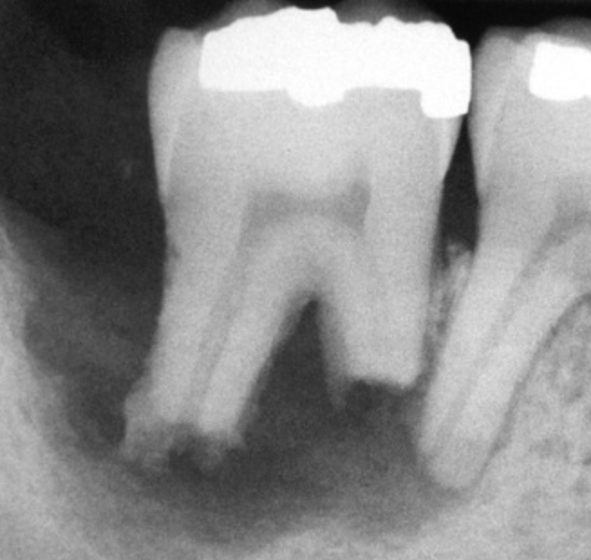
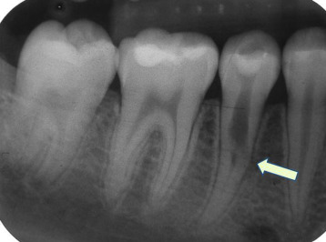
Traumatized Tooth Difficulties:
Traumatized primary and permanent teeth exhibit a variety of difficulties and effects:
pulpal hyperemia: congestion of blood within the pulp chamber.
internal hemorrhage: rupture of pulpal capillaries.
internal/external resorption: destructive, dissolving process caused by odontoclastic action.

Slide 32
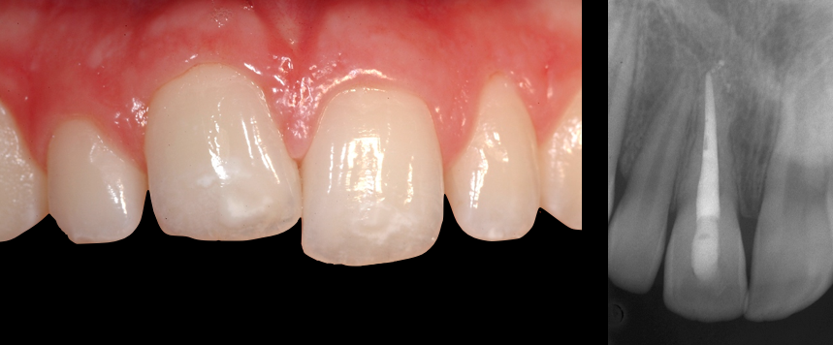
pulpal necrosis: pulpal death.
ankylosis :fusion of cementum of the root with the cribriform plate of the alveolar bone with no intervening periodontal ligament.

Slide 33
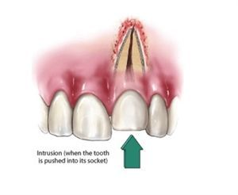
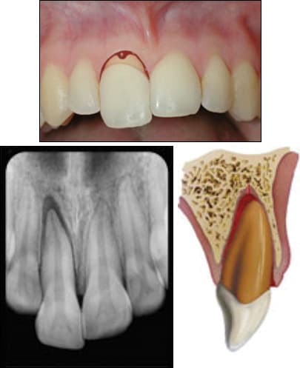
intrusion: tooth thrust into the alveolus with partial crown exposure.
extrusion: tooth thrust away from the alveolus.

Slide 34
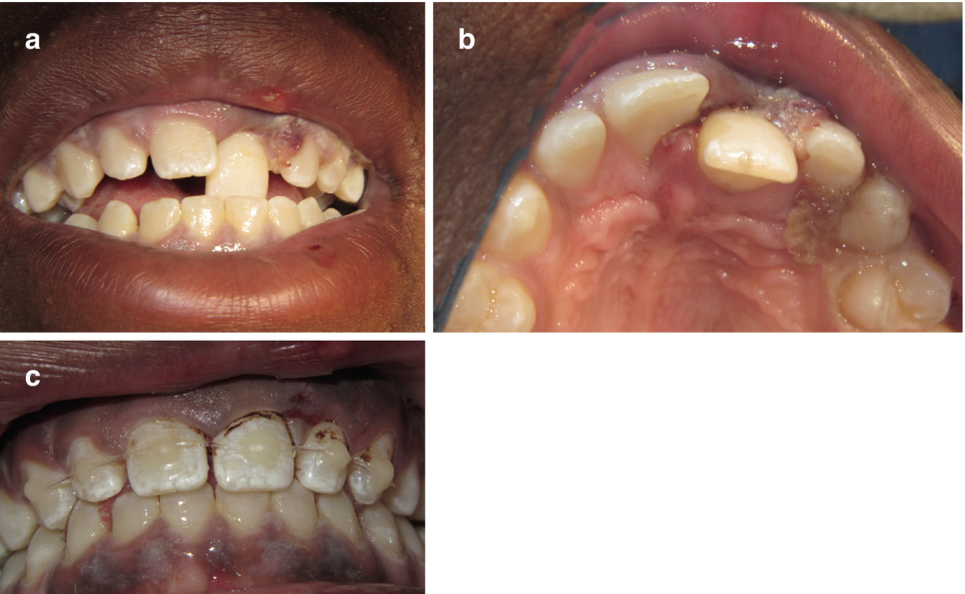
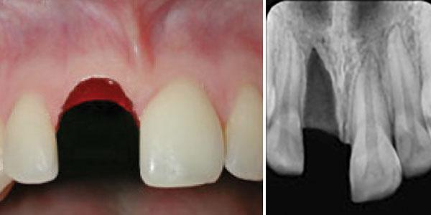
luxation: tooth moved out of place.
avulsion: tooth forced out of its socket

Slide 35
Treatment of Traumatized Teeth:
Treatment for injured primary teeth may include the following:
Smoothing of rough edges
Pulp capping
Pulpotomy
Pulpectomy with or without endodontic treatment
Stainless steel banding, metal or resin crowns, placement of posts
Replantation and stabilization (splinting) of replantation
Partial denture tooth replacement
Other indications of abuse such as facial, neck, or hand bruises; bite marks; irregular walking gait; fear of adults; difficulty in sitting; eye contact avoidance; and unusual comments should be investigated and followed through proper channels.

Slide 36
Use of Dental Records for Patient Identification:
Dental records are being used extensively for identification in forensic and legal matters. The dental office offers many methods for recording and maintaining positive identification items for future reference. With particular attention to missing children, the pedodontist may supply information collected during routine visits.

Slide 37
Personal information data: name, address, nicknames, ethnicity, hobbies, eyeglasses, tattoos, scars, birthmarks, and so forth.
Dental charting record: current tooth development, dentition characteristics, and treatment data.
Radiographs: current tooth placement, expected tooth development, and evidence of treatment received.
Photographs: frontal and side views with profile and tooth growth. Digital photos have the advantage of providing immediate images that can be transmitted in missing child cases.
Toothprint: a thermoplastic wafer impression record of the child’s unique occlusion.
Saliva: fluid collection containing the child’s DNA and scent for use with tracking dogs in missing child cases.

Slide 39
2. Endodontics

Slide 40
Science and Practice of Endodontic Dentistry:
Endodontia (within the tooth) is the branch of dentistry concerned with the diagnosis, treatment, and prevention of diseases of the dental pulp and its surrounding periradicular (around, radi = root) tissues. The dental specialist who completes an additional two to three years of training and board testing becomes a Diplomate of Endodontics and limits his or her practice to this specialty as an endodontist . Many general dentists complete endodontic therapy in their practice but may refer difficult cases to the endodontic specialist.

Slide 41
The endodontic treatment or procedure necessary to treat an inflamed pulpal condition, also know as pulpitis , depends on the condition of the inner tooth tissues. The inflamed pulp tissue may be afflicted with a reversible treatable condition if the fibers are vital or alive and the pulp may recover. Diseased pulp tissue that cannot recover and repair itself is considered necrotic (= dead or nonvital ), an irreversible condition. Diagnosis and future treatment is determined by endodontic diagnostic testing of the affected tooth and its surrounding tissues.The next Table lists diagnostic conditions of pulpitis.

Slide 43
Diagnostic Procedures to Determine Pulpal Conditions:
Evaluation of the pulp’s vitality consists of an assortment of tests, both subjective and objective. All evaluations begin with a review of the patient’s dental history and questioning from the dentist to reveal the patient’s complaints. Related terms are:
subjective symptoms: conditions as described by the patient. An example of a subjective symptom may be a patient complaint of hypersensitivity (hyper = over, sensitivity = abnormal reaction to stimulus) or pulpalgia (pulp = inner tooth tissue, algia = pain); the type of pain, such as spontaneous or dull, throbbing; what causes the pain’s onset; what relieves the pain; and when it occurs are clues to help determine pulpal life.
objective signs: conditions observed by someone other than the patient. Examples are a tooth hyperextension (hyper = over, extension = movement), a condition in which the tooth arises out of the socket, or a noticeable, unpleasant odor known as putrefaction (= decaying animal matter). A dark-colored tooth may indicate internal bleeding from trauma or infection; swelling of the face or gingival area may be present.

Slide 44
Clinical examination:
Palpation: application of finger pressure to body tissues, including gingiva.
Percussion: (=tapping of body tissue,tooth), usually done by tapping a dental mirror handle on an affected tooth and comparing the sensation to tapping on a healthy or control tooth.
Mobility: (=capable of movement) movement of a tooth in its socket during outside force or pressure application.
Transillumination: (=passage of light through object/tissue): a light refraction test to reveal fractured tooth tissue.
Thermal: (=pertaining to temperature): pulp sensitivity test with reaction to applications of heat and /or cold to tooth surface.
Anesthesia: numbing the questionable root or nerve ending to dissipate pain.
Direct dentin stimulation: scratching the exposed dentin with an explorer; the presence of pain indicates inflamed or irritated pulp tissue.
Electric pulp testing: applying an electrical current on the enamel surface of the tooth to register the tooth`s pulpal sensitivity and presence of irritability.

Slide 45
Mobility testing of a tooth, using the back ends of two mirror handles.
Percussion testing of a tooth, using the back end of a mirror handle.

Slide 46
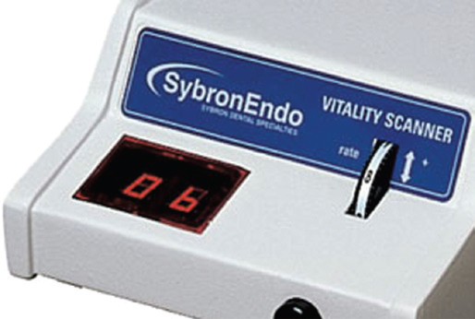
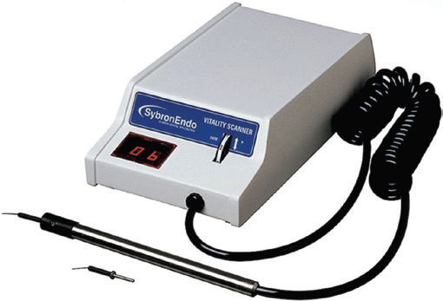
A, Electric pulp tester with probe. The probe tip will be coated with a conducive medium such as toothpaste and placed in contact with the tooth surface. The patient will activate the unit by placing a finger on the metal shaft of the probe. B, View of the electric pulp tester control panel; the knob on the front right of the unit controls the rate at which the electric current is delivered to the tooth. The plastic panel on the left front displays the digital numerical reading obtained from the pulp test. The digital scale runs from 0 to 80.

Slide 47
CLINICAL CLASSIFICATION OF PULPAL AND PERIAPICAL DISEASES:
Pulpal Disease:
Normal Pulp:
the pulp is symptom-free and normally responsive to pulp testing. Teeth with normal pulp do not usually exhibit any spontaneous symptoms.
Pulpitis:
This is a clinical and histologic term denoting inflammation of the dental pulp, clinically described as reversible or irreversible and histologically described as acute, chronic, or hyperplastic.

Slide 48
Reversible Pulpitis:
This is a clinical diagnosis based on subjective and objective findings indicating that the inflammation should resolve and the pulp return to normal.
Irreversible Pulpitis
As the disease state of the pulp progresses, the inflammatory condition of the pulp can change to irreversible pulpitis. At this stage, treatment to remove the diseased pulp will be necessary.

Slide 49
Pulp Necrosis
This is a clinical diagnostic category indicating death of the dental pulp. The pulp is usually nonresponsive to pulp testing.
Previously Treated
This is a clinical diagnostic category indicating that the tooth has been endodontically treated and the canals are obturated with various filling materials other than intracanal medicaments.
Previously Initiated Therapy
This is a clinical diagnostic category indicating that the tooth has been previously treated by partial endodontic therapy (e.g., pulpotomy, pulpectomy).

Slide 50
Apical (Periapical) Disease
Normal Apical Tissues:
In this category the patient is asymptomatic and the tooth responds normally to percussion and palpation testing.
Periodontitis
This classification refers to an inflammation of the periodontium. When located in the periapical tissues it is referred to as apical periodontitis.
Acute Apical Abscess
This condition is defined as an inflammatory reaction to pulpal infection and necrosis characterized by rapid onset, spontaneous pain, tenderness of the tooth to pressure, pus formation, and swelling of associated tissues.
Chronic Apical Abscess
This condition is defined as an inflammatory reaction to pulpal infection and necrosis characterized by gradual onset, little or no discomfort, and the intermittent discharge of pus through an associated sinus tract

Slide 51
REFERRED PAIN
The perception of pain in one part of the body that is distant from the actual source of the pain is known as referred pain. Whereas pain of nonodontogenic origin can refer pain to the teeth, teeth may also refer pain to other teeth as well as to other anatomic areas of the head and neck . This may create a diagnostic challenge, in that the patient may insist that the pain is from a certain tooth or even from an ear when, in fact, it is originating from a distant tooth with pulpal pathosis.

Slide 52
Instruments for access cavity preparation:
Turbine,Handpiece and burs

Slide 53
Burs
Several types of burs will be used to accomplish good access preparation. Fissure burs are used in the initial stage of access preparation to establish the correct outline form, round burs are used to lift the roof of the pulp chamber and eliminate overhanging dentine.

Slide 54
Safe-ended diamond or endo-Z burs are used to refine the preparation

Slide 55
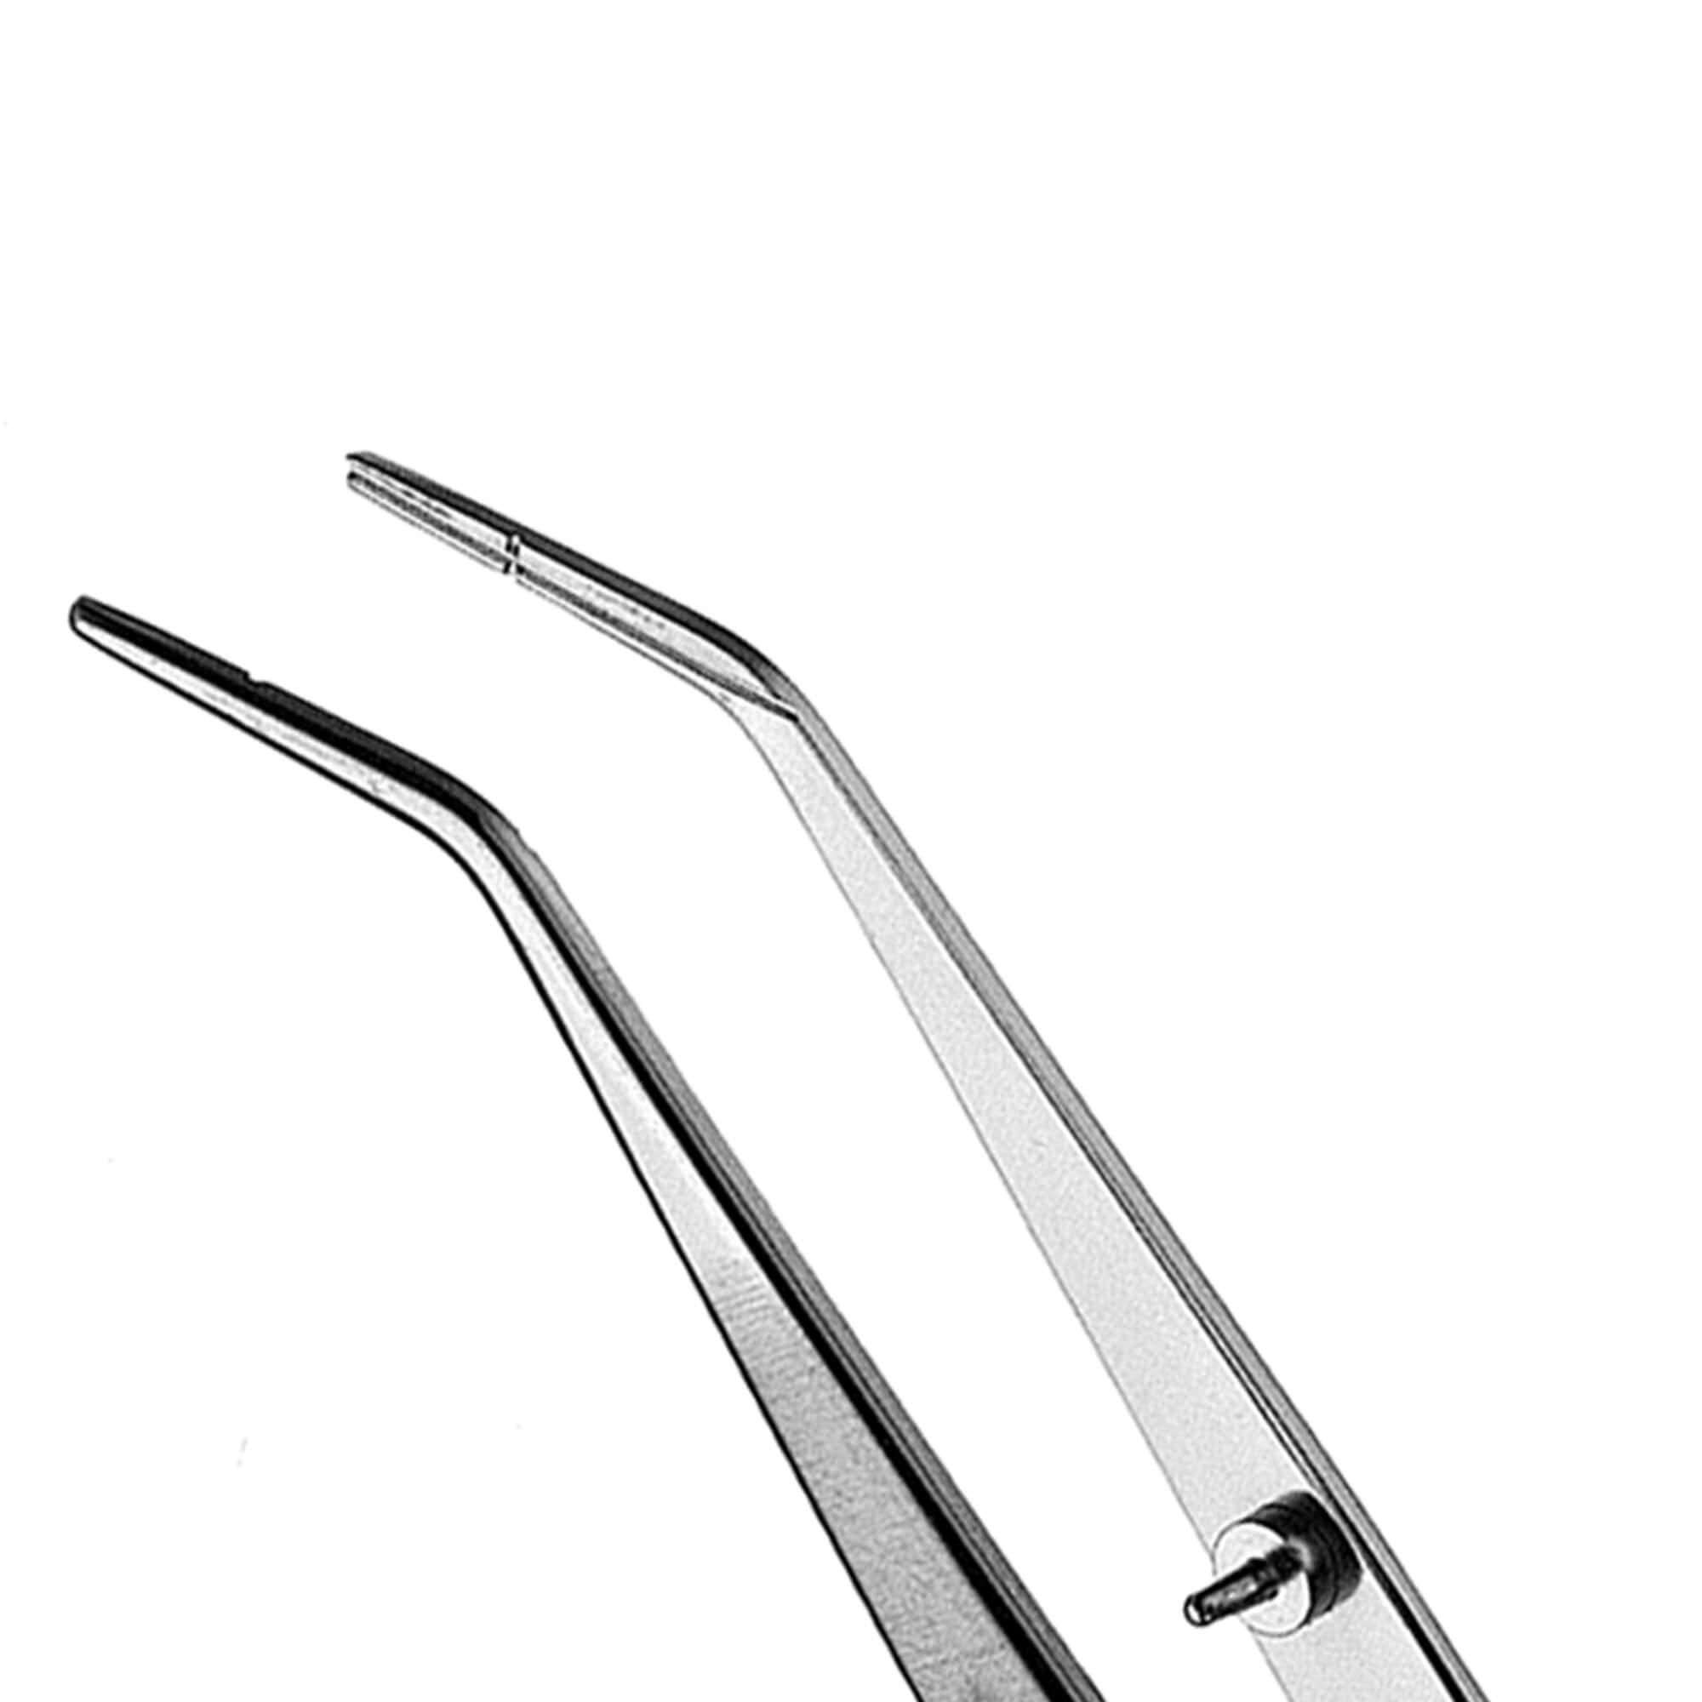
Root canal explorer:
Used to probe and detect canal opening within the pulp chamber.
Endodontic plier:
Nonlocking and locking pliers for gutta-percha and absorbent points. The working part has grooves for holding of points.

Slide 56
Endodontic spoon excavator:
Larger than conventional exacavator “ its shape allows curettage of the pulp chamber when conventional one will not reach the floor of the chamber and used as surgical aid to excavate periapical lesion.

Slide 57
Instrument handles should be color coded for their easier recognition ( pink, grey, purple, white, yellow, red, blue, green, black,…..)

Slide 58
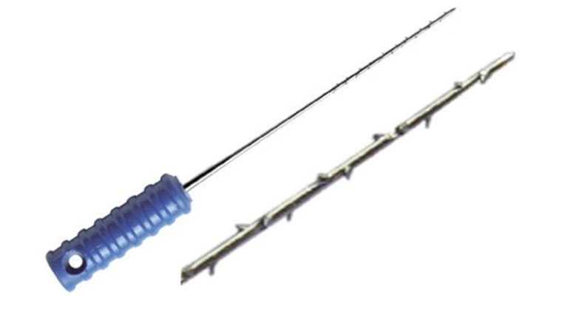
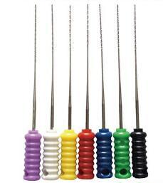
The braded broach comes in different sizes, and the selection of suitable size is very important, it should fit lossely inside the canal, when braded broach size is larger than the canal size, the hooks of B.B engaged in the dentinal wall of the canal and stick there and with drawing it becomes difficult and might fracture inside the canal. The B.B must only be used in the straight part of the canal.

Slide 59
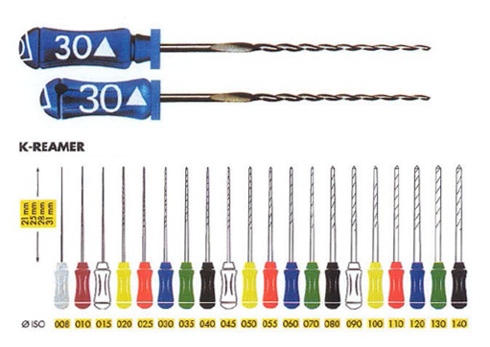
Reamers:
Reamers are K-type instruments, which are used to ream the canals. They cut by inserting into the canal, twisting clockwise one quarter to half turn and then withdrawing, i.e penetration, rotation and retraction.
Reamers have triangular blank and lesser number of flutes than files.

Slide 60
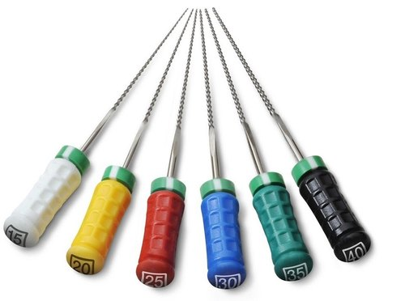
Files:
Files are the instruments used during cleaning and shaping of the root canals for machining of the dentin. Since Kerr company was first to produce them, the files were also called K-files.
Files are predominantly used with filling or rasping action in which there is little or no rotation in the root canals. It is placed in root canal and pressure is exerted against the canal wall and instrument is withdrawn while maintaining the pressure.

Slide 61
Difference between files and reamers
Reamers | Files
Triangular | Square | 1. Cross-section
less | more | 2.Area of cross section
(0.5-1mm)less | more(1.5-2mm) | 3. Flutes
more(because of less work hardening) | less | 4.Flexibility
rotation and retraction | Rasping penetration (push and pull) | 5.Cutting motion
round | usually avoid | preparation shape
better because of space present in flutes | poor because of tighter flutes | transport of debris

Slide 62
Though reamer has fewer numbers of flutes than file, cutting efficiency is same as that of files because more space between flutes causes better removal of debris.
Reamer tends to remain self centered in the canal resulting in less chances of canal transportation.

Slide 63
Types of files:
1. k-files :
They are triangular, square or rhomboidal in cross section, manufactured from stainless steel wire which is grounded into desired shape.
Tighter twisting of the file spirals increases the number of flutes in files (more than reamer).
Triangular cross-sectioned files show superior cutting and increased flexibility than the file or reamers with square blank.

Slide 64
2- K- flex Files :
It was realized that square blank of file results in total decrease in the instrument flexibility. To maintain shape and flexibility of these files, k-flex files were introduced.
K-flex files are rhombus in cross section having two acute angles and two obtuse angles.
They are used in filing and rasping motion.

Slide 65
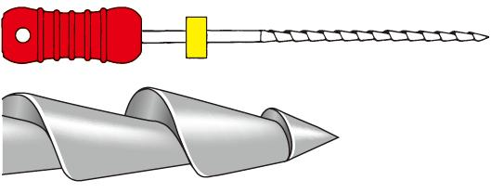
3- Hedstrom files (H –files):
Hedstrom files have flutes which resemble successively triangles set one on another.

Slide 66
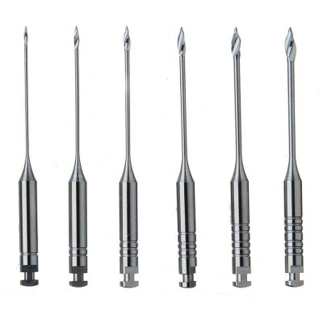
ENGINE DRIVEN INSTRUMENT
1-Gates-Glidden Burs
Traditional engine driven instruments include Gates-Glidden drills which have flame-shaped cutting point mounted on long thin shaft attached to a latch type shank.
Gates-Gliddens are available in a set from 1 to 6 with the diameters from 0.5 to 1.5 mm.
Due to their design Gates-Glidden drills are side cutting instruments with safety tips

Slide 67
They should be used at the speed of 750-1500 rpm in brushing strokes.
Safety design of Gates-Gliddens is that its weakest part lies at the junction of shank and shaft of the instrument. If its cutting tip jams against the canal wall, fracture occurs at the junction of shank and the shaft but not at the tip of the instrument. This makes the easy removal of fractured drill from the canal.

Slide 68
2-PEESO REAMERS
They are rotary instruments used mainly for post apace preparations.
They have safe ended non-cutting tip.
Their tip diameter varies from 0.7 to 1.7 mm.
They should be used in brushing motion.
Disadvantages of using peeso reamers are:
They do not follow the canal curvature and may cause perforation by cutting laterally.
They are stiff instruments.
They have to be used very carefully to avoid iatrogenic errors.

Slide 69
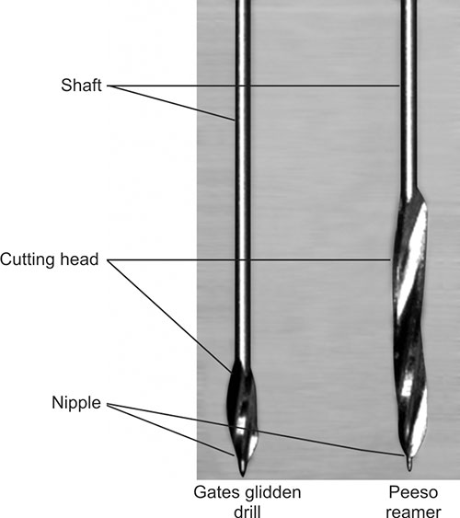

Slide 70
Disposable irrigating syringe and disposable needle

Slide 71
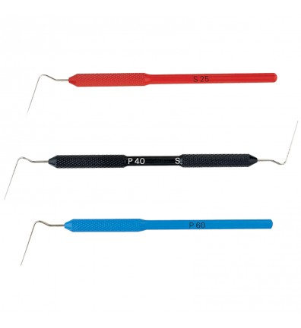
Instruments used for root canal filling
Spreaders and pluggers
Are the instruments used to compact the gutta-percha into root canal during obturation.
Hand Spreaders
They are made from stainless steel and are designed to facilitate the placement of accessory gutta-percha points around the master cone during lateral compacting technique.
These spreaders do not have standardized size and shape.

Slide 72
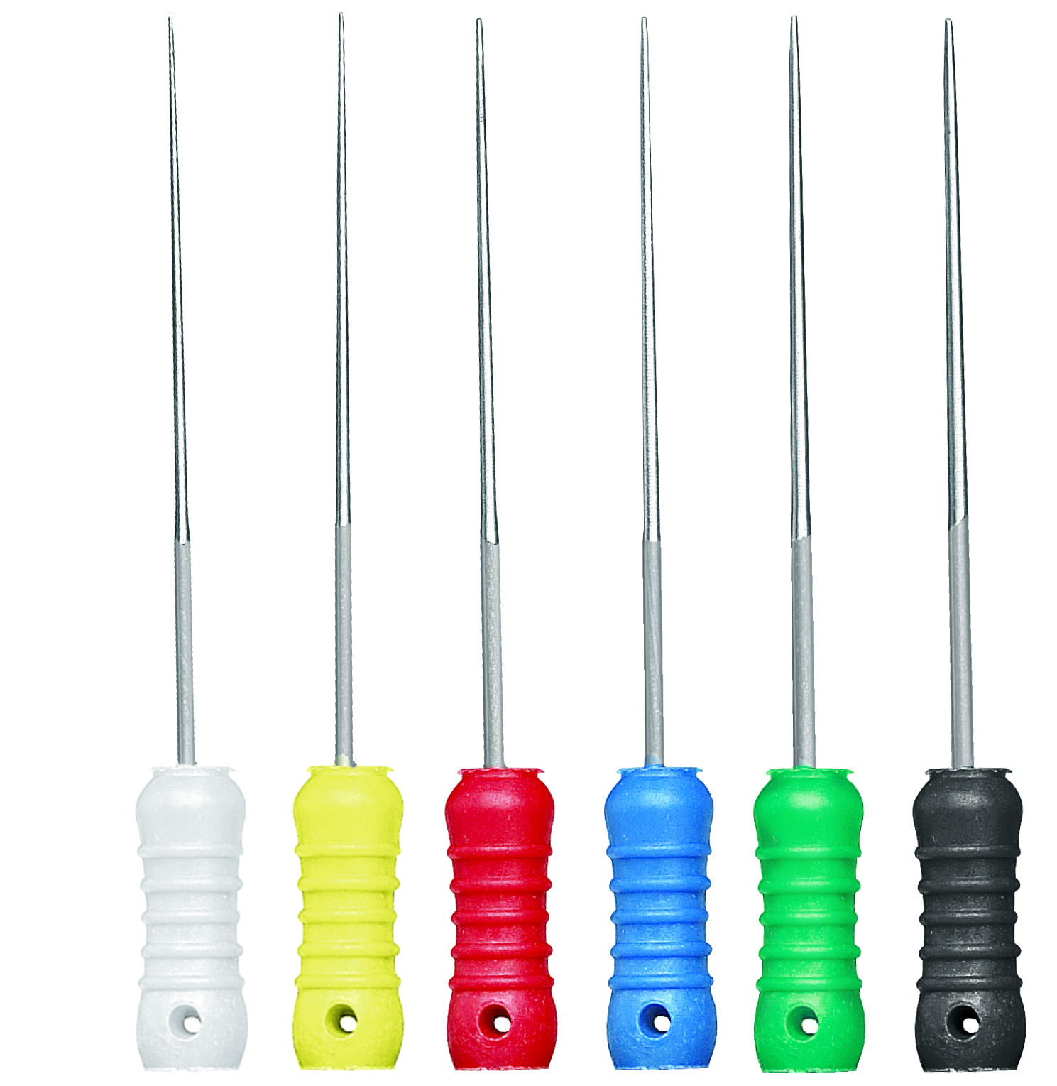
B- Finger Spreaders
They are shorter in length which allows them to afford a great degree of tactile sense and allow them to rotate freely around their axis.
They are standardized and color coded to match the size of gutta-percha points.
They can be manufactured from stainless steel or nickel titanium.

Slide 73
Pluggers.
Hand Pluggers.
They consist of diameter larger than spreader and have blunt end.
They are used to compact the warm gutta-percha vertically and laterally into the root canal.
They may also be used to carry small segments of gutta-percha into the canal during sectional filling technique.
Calcium hydroxide or MTA like materials may also be packed into the canals using pluggers.

Slide 74
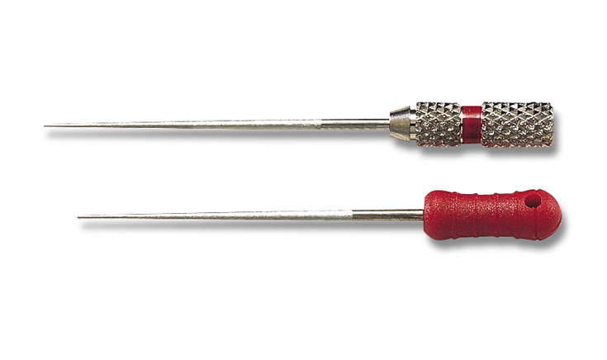
B-finger Pluggers
They are used for vertical compaction of gutta-percha. They apply controlled pressure while compaction, and have more tactile sensitivity than hand plugger.

Slide 75
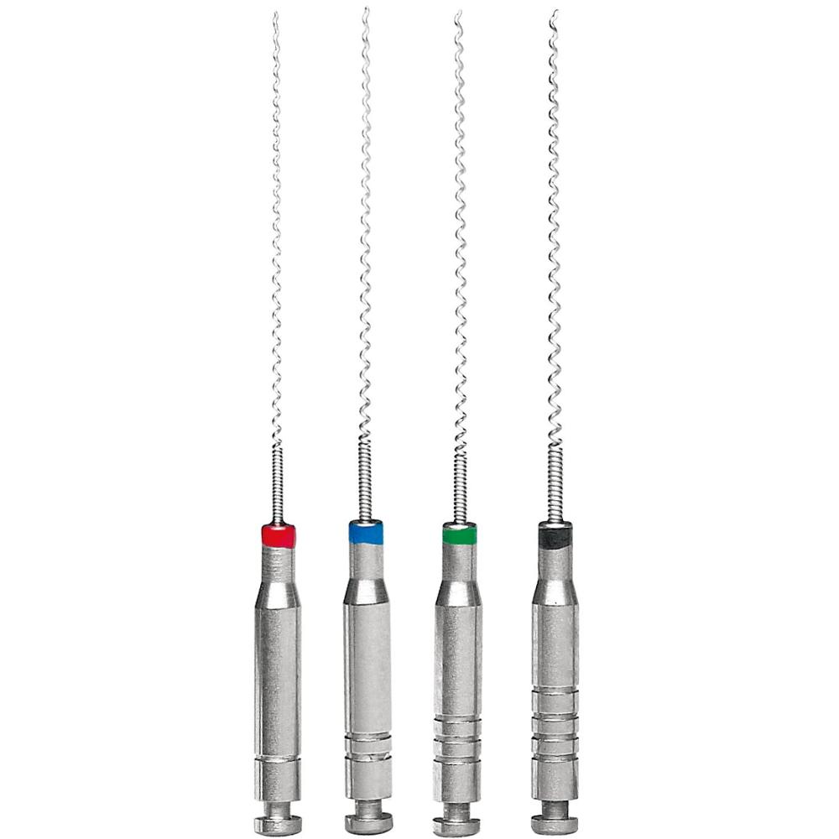
Lentulo spiral:
They are used for applying sealer to the root canal walls before obturation.
They can be used as hand or rotary instruments.

Slide 76
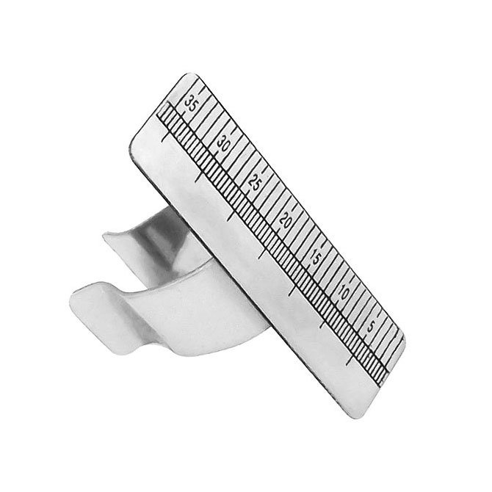
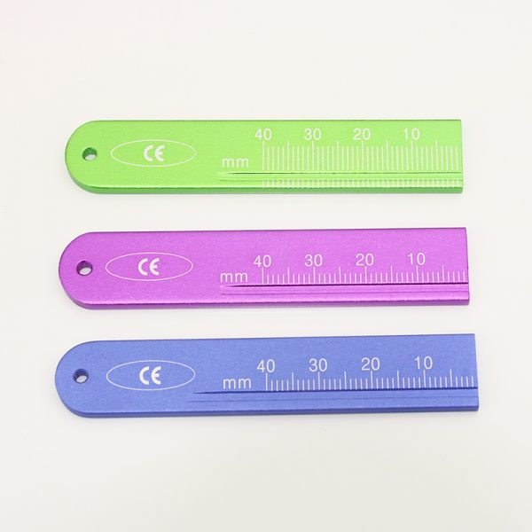
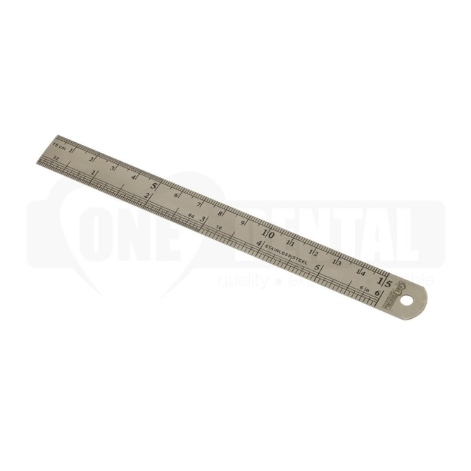
Endodontic ruler:
Used for measuring the length of instruments.

Slide 77
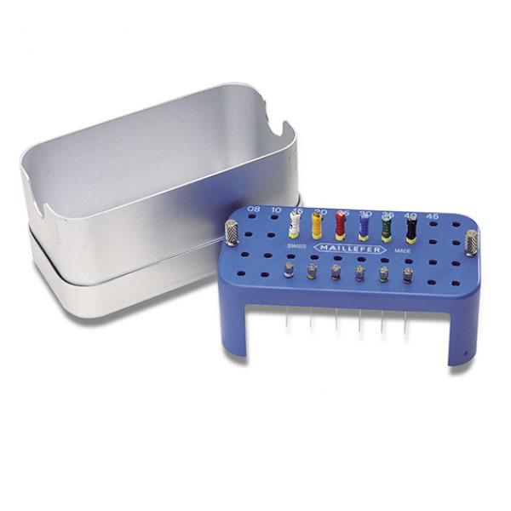
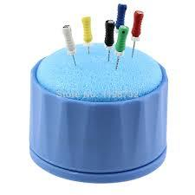
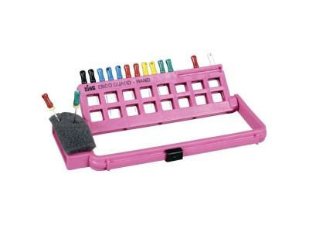
Endodontic block or Transfer sponge:
Used to organize and hold endodontic finger and rotary instruments during procedures.
Reduces the possibility of percutaneous injuries when handing endodontic finger and rotary instruments

Slide 78
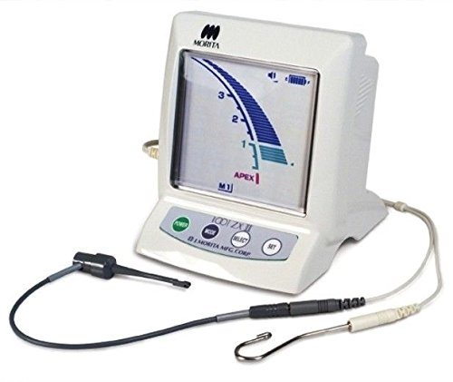
Electronic Apex Locators
An electronic instrument used to determine the distance to the apical foramen.
The screen allows the operator to visualize the file movement during instrumentation.

Slide 79
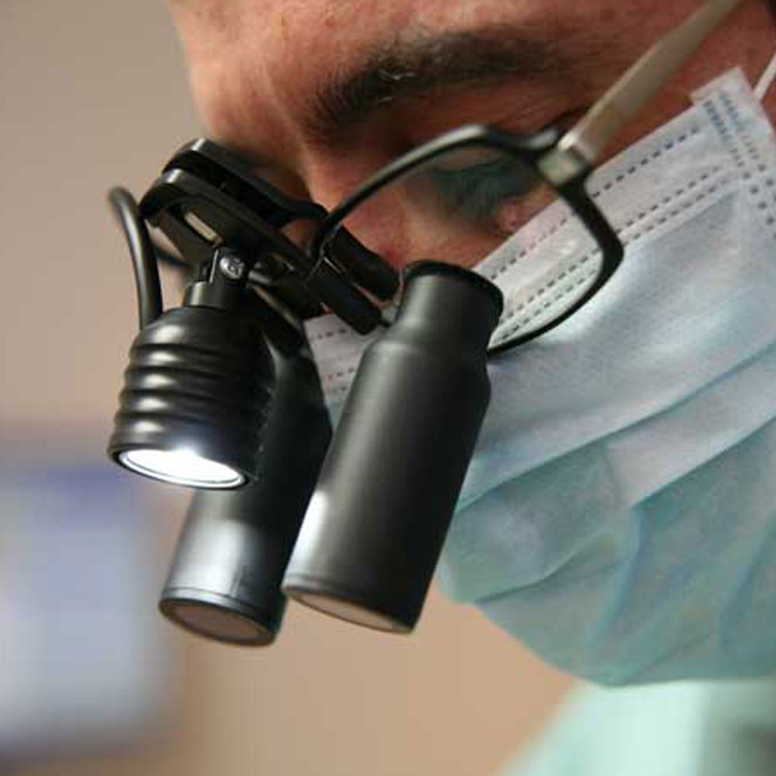
Operation loupes and microscopes
Illumination and magnification are vital for the location of root canals. The endodontist would use a surgical microscope while a general dental practitioner might have loupes and a headlight that give excellent magnification and illumination.

