Slide 1
الجلسة السابعة – عملي – هياكل واحتكاك
د. نزار عبد الرحمن
https://manara.edu.sy/

Slide 2
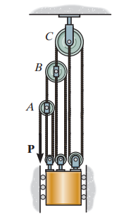
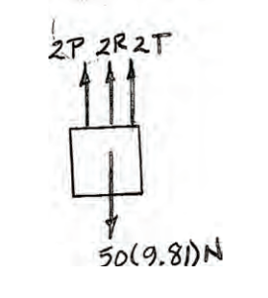
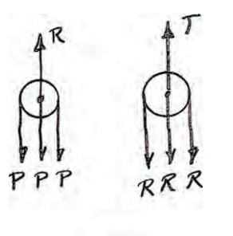
Example 1:Determine the force required to hold the 50-kg mass in equilibrium.
https://manara.edu.sy/

Slide 3
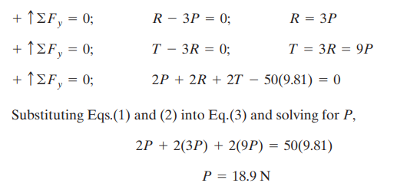
SOLUTION :Equations of Equilibrium: Applying the force equation of equilibrium along the y axis of each pulley.
https://manara.edu.sy/

Slide 4
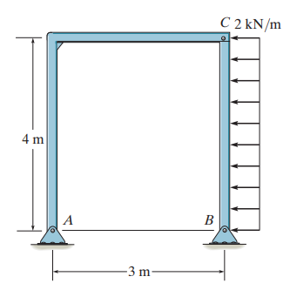
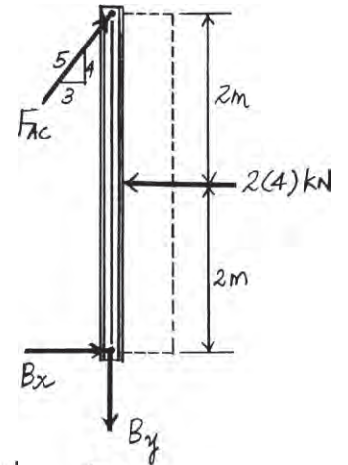
Example 2:Determine the horizontal and vertical components of force that pins A and B exert on the frame.
https://manara.edu.sy/

Slide 5
Solution: Free Body Diagram. The frame will be dismembered into members BC and AC. The solution will be very much simplified if one recognizes that member AC is a two force member. The FBDs of member BC and pin A are shown in Figs. a and b, respectively
Equations of Equilibrium. Consider the equilibrium of member BC
https://manara.edu.sy/

Slide 6
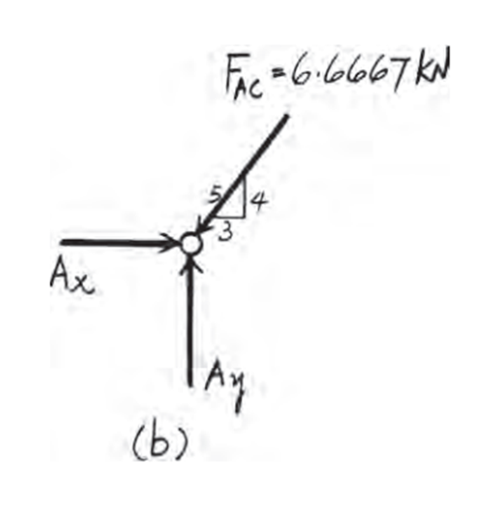
Then, the equilibrium of pin A gives
https://manara.edu.sy/

Slide 7
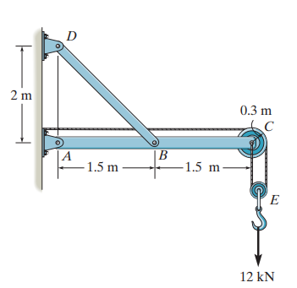
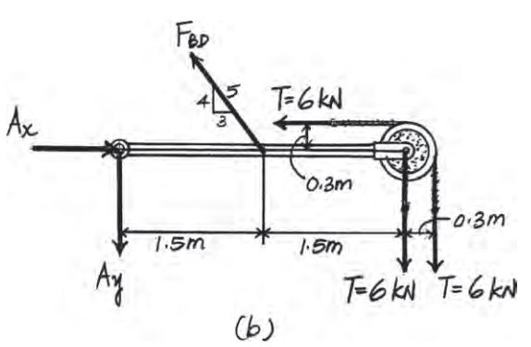
Example3 :Determine the horizontal and vertical components of force at pins A and D
https://manara.edu.sy/

Slide 8
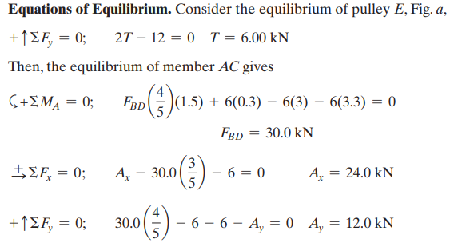
Solution: Free Body Diagram. The assembly will be dismembered into member AC, BD and pulley E. The solution will be very much simplified if one recognizes that member BD is a two force member. The FBD of pulley E and member AC are shown in Fig. a and b respectively.
https://manara.edu.sy/

Slide 9
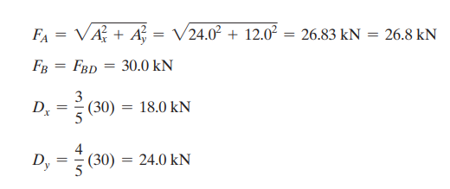
https://manara.edu.sy/

Slide 10
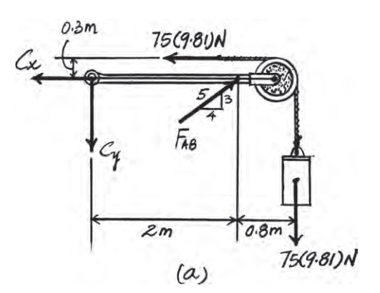
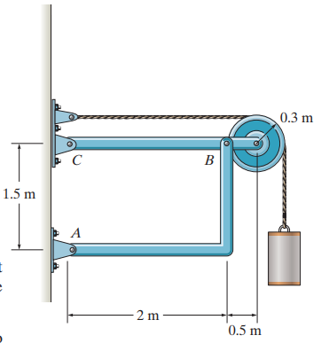
Example 4: Determine the horizontal and vertical components of force at pins B and C. The suspended cylinder has a mass of 75 kg.
https://manara.edu.sy/

Slide 11
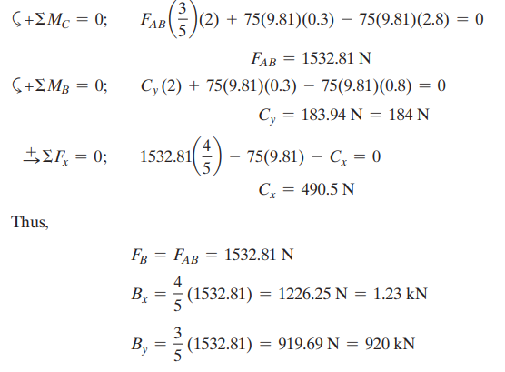
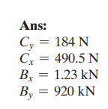
Equations of Equilibrium. Consider the equilibrium of member BC by referring to its FBD, Fig. a
https://manara.edu.sy/

Slide 12
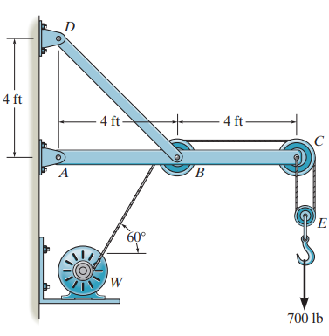
Example 5 :The wall crane supports a load of 700 lb. Determine the horizontal and vertical components of reaction at the pins A and D. Also, what is the force in the cable at the winch W?
SOLUTION :
Pulley E:
https://manara.edu.sy/

Slide 13
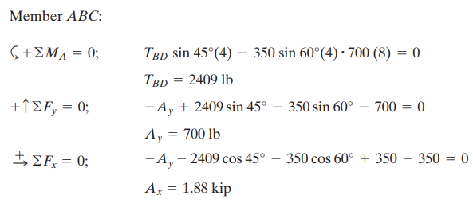
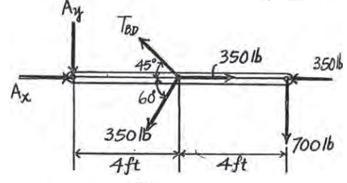
https://manara.edu.sy/

Slide 14
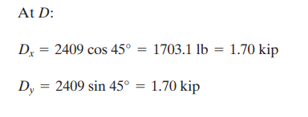
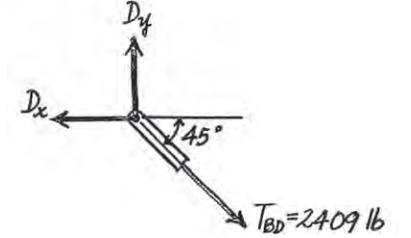
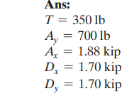
https://manara.edu.sy/

Slide 15
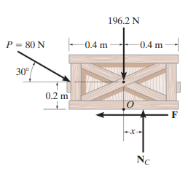
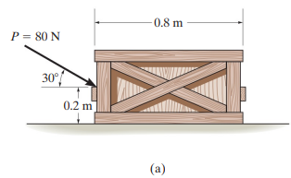
الاحتكاك
Example1:The uniform crate has a mass of 20 kg. If a force P = 80 N is applied to the crate, determine if it remains in equilibrium. The coefficient of static friction is µs = 0.3.
https://manara.edu.sy/

Slide 16
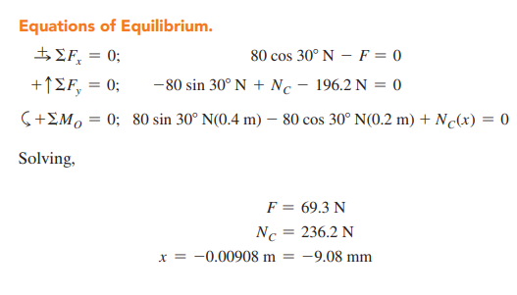
https://manara.edu.sy/

Slide 17
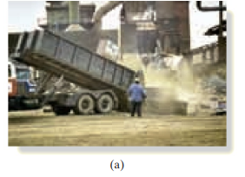
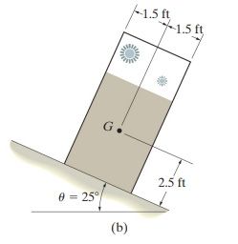
Example 2 : It is observed that when the bed of the dump truck is raised to an angle of u = 25 the vending machines will begin to slide off the bed. Determine the static coefficient of friction between a vending machine and the surface of the truck bed.
https://manara.edu.sy/

Slide 18
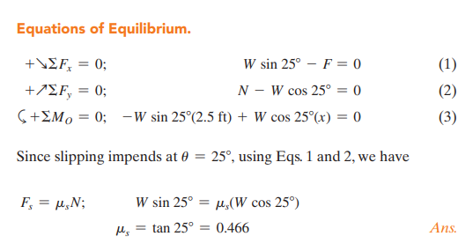
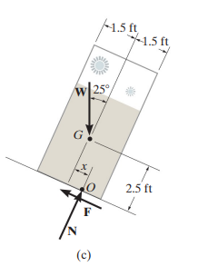
https://manara.edu.sy/

Slide 19
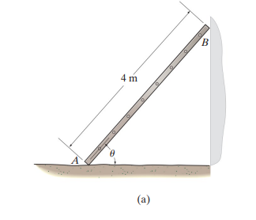
Example3 :The uniform 10-kg ladder rests against the smooth wall at B, and the end A rests on the rough horizontal plane for which the coefficient of static friction is µs = 0.3. Determine the angle of inclination u of the ladder and the normal reaction at B if the ladder is on the verge of slipping.
https://manara.edu.sy/

Slide 20
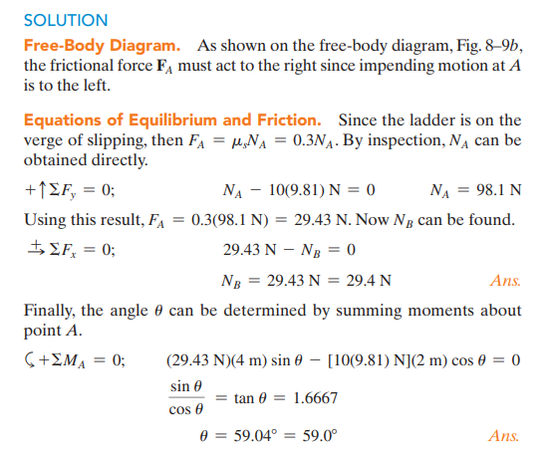
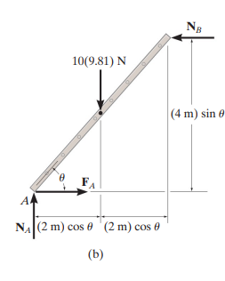
https://manara.edu.sy/

Slide 21
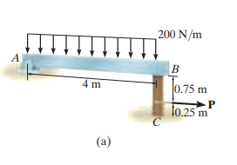
Example4 :Beam AB is subjected to a uniform load of 200 N.m and is supported at B by post BC,. If the coefficients of static friction at B and C are µB = 0.2 and µC = 0.5, determine the force P needed to pull the post out from under the beam. Neglect the weight of the members and the thickness of the beam.
https://manara.edu.sy/

Slide 22
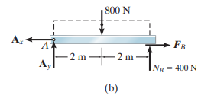
https://manara.edu.sy/

Slide 23
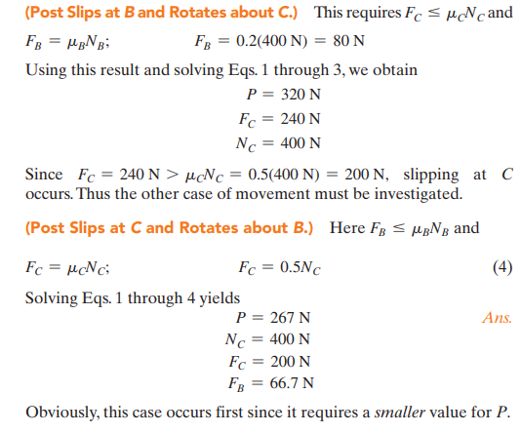
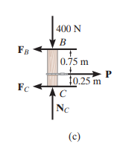
https://manara.edu.sy/

Slide 24
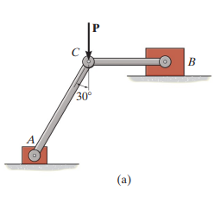
Example 5:Blocks A and B have a mass of 3 kg and 9 kg, respectively, and are connected to the weightless links. Determine the largest vertical force P that can be applied at the pin C without causing any movement. The coefficient of static friction between the blocks and the contacting surfaces is µs = 0.3
https://manara.edu.sy/

Slide 25
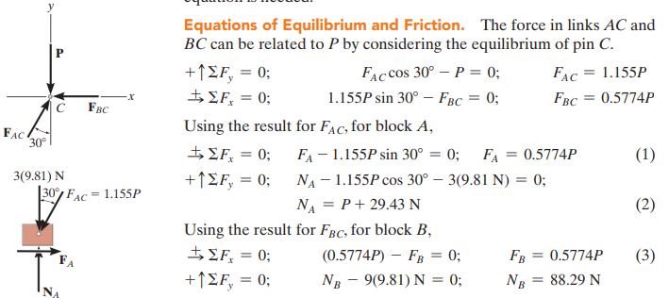
https://manara.edu.sy/

Slide 26
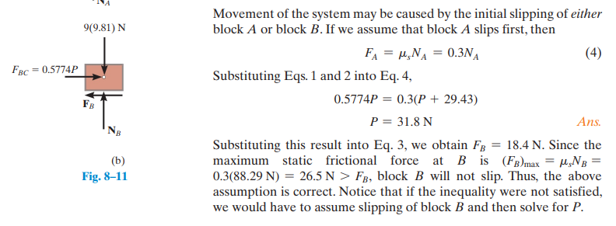
https://manara.edu.sy/

Slide 27
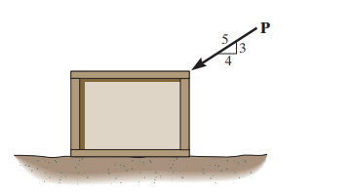
Example 6:Determine the friction developed between the 50-kg crate and the ground if a) P = 200 N, and b) P = 400 N. The coefficients of static and kinetic friction between the crate and the ground are µs = 0.3 and µk = 0.2
https://manara.edu.sy/

Slide 28
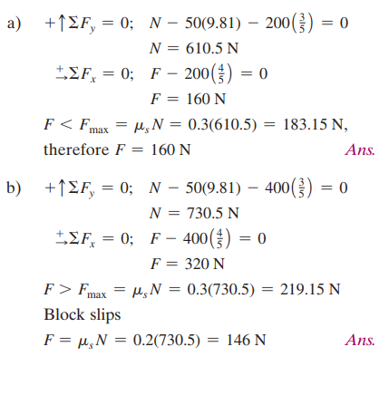
https://manara.edu.sy/

Slide 29
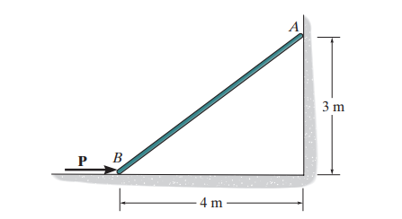
Example 7:Determine the minimum force P to prevent the 30-kg rod AB from sliding. The contact surface at B is smooth, whereas the coefficient of static friction between the rod and the wall at A is µs = 0.2
https://manara.edu.sy/

Slide 30
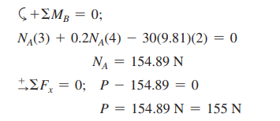
https://manara.edu.sy/

Slide 31
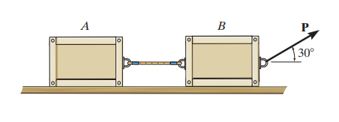
Example8 :Determine the maximum force P that can be applied without causing the two 50-kg crates to move. The coefficient of static friction between each crate and the ground is µs = 0.25
https://manara.edu.sy/

Slide 32
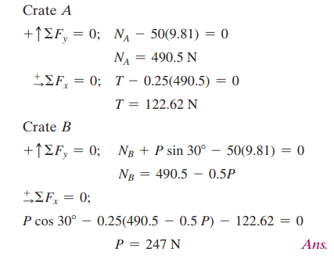
https://manara.edu.sy/

Slide 33
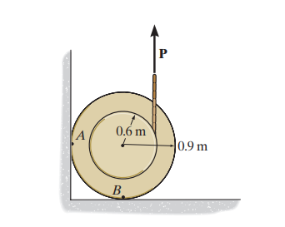
Example9: If the coefficient of static friction at contact points A and B is µs = 0.3, determine the maximum force P that can be applied without causing the 100-kg spool to move
https://manara.edu.sy/

Slide 34
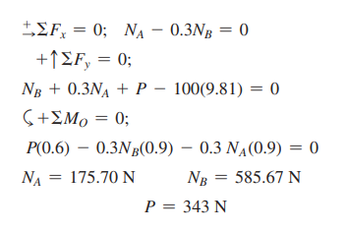
https://manara.edu.sy/

Slide 35
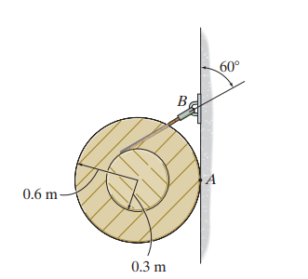
Example 10:Determine the minimum coefficient of static friction between the uniform 50-kg spool and the wall so that the spool does not slip.
https://manara.edu.sy/

Slide 36
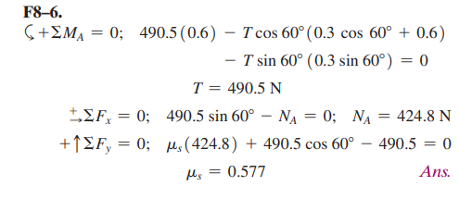
https://manara.edu.sy/

Slide 37
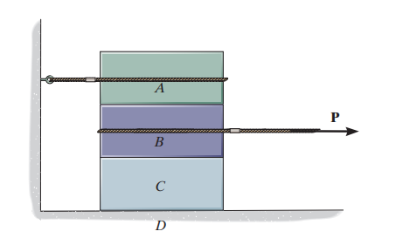
Example11: Blocks A, B, and C have weights of 50 N, 25 N, and 15 N, respectively. Determine the smallest horizontal force P that will cause impending motion. The coefficient of static friction between A and B is µs = 0.3, between B and C, µ s = 0.4, and between block C and the ground, µs = 0.35
https://manara.edu.sy/

Slide 38
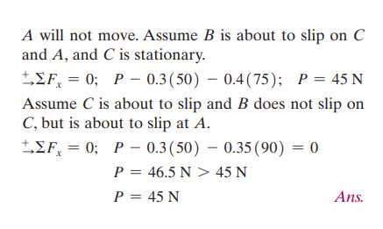
https://manara.edu.sy/

Slide 39
Example12 :Blocks A and B have a mass of 7 kg and 10 kg, respectively. Using the coefficients of static friction indicated, determine the largest force P which can be applied to the cord without causing motion. There are pulleys at C and D
https://manara.edu.sy/

Slide 40
https://manara.edu.sy/

