Slide 1
عميد الكلية د. إياد حاتم
قسم الروبوت و الأنظمة الذكية

Slide 2
المحاضرة العاشرة
نظم التحكم اللاخطي
Nonlinear Control systems
مدرس المقرر
د.بلال شيحا

Slide 3
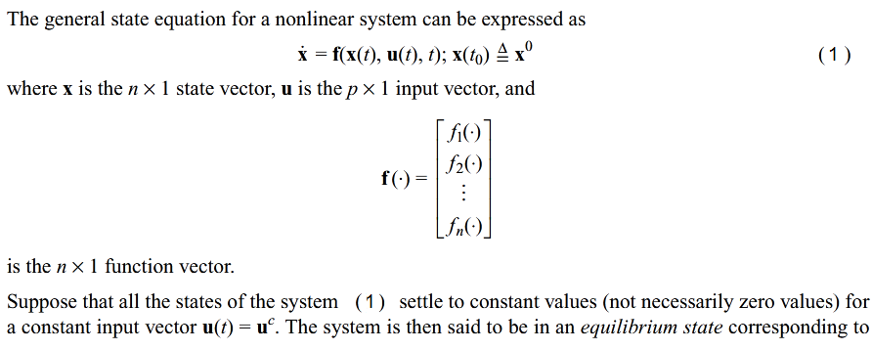
LYAPUNOV STABILITY
LYAPUNOV STABILITY DEFINITIONS

Slide 4
LYAPUNOV STABILITY
LYAPUNOV STABILITY DEFINITIONS

Slide 5
LYAPUNOV STABILITY

Slide 6
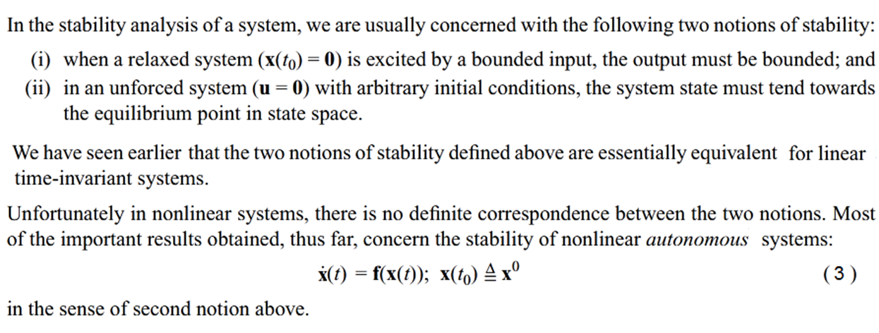
LYAPUNOV STABILITY
LYAPUNOV STABILITY DEFINITIONS

Slide 7
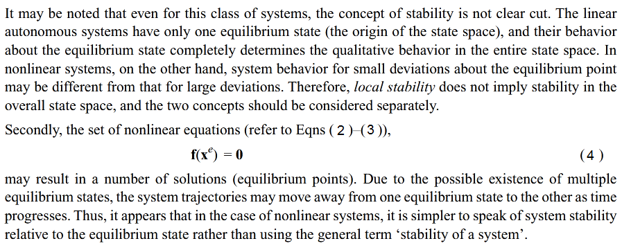
LYAPUNOV STABILITY
LYAPUNOV STABILITY DEFINITIONS

Slide 8
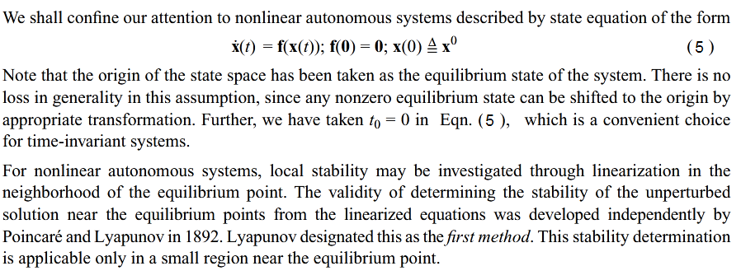
LYAPUNOV STABILITY
LYAPUNOV STABILITY DEFINITIONS

Slide 9
LYAPUNOV STABILITY
LYAPUNOV STABILITY DEFINITIONS

Slide 10
LYAPUNOV STABILITY
LYAPUNOV STABILITY DEFINITIONS

Slide 11
LYAPUNOV STABILITY
LYAPUNOV STABILITY DEFINITIONS

Slide 12
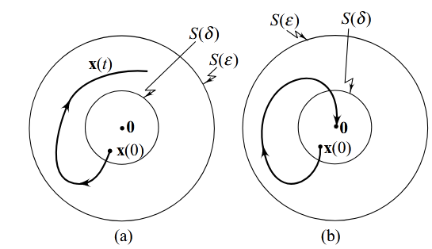
LYAPUNOV STABILITY
LYAPUNOV STABILITY DEFINITIONS
Note that this definition of stability permits the existence of continuous oscillation about the equilibrium point.
The state-space trajectory for such an oscillation is a closed path. The amplitude and frequency of the oscillation may influence whether it represents acceptable performance.

Slide 13
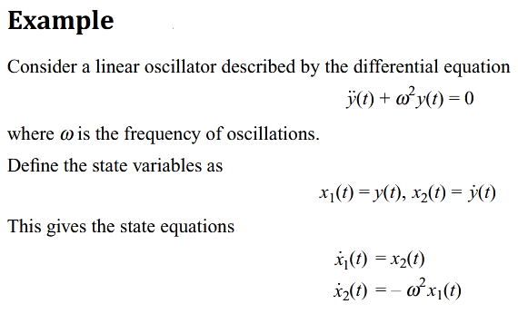
LYAPUNOV STABILITY
LYAPUNOV STABILITY DEFINITIONS

Slide 14
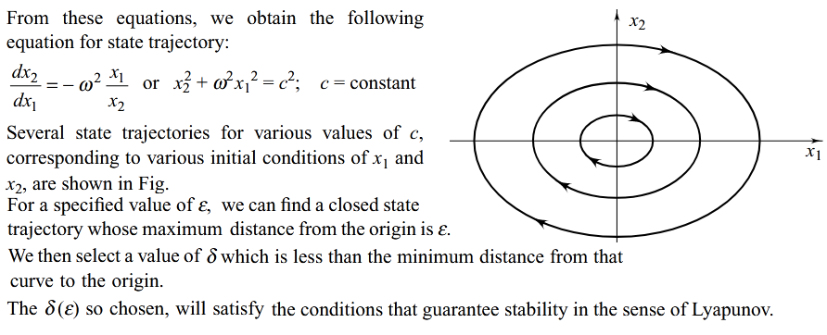
LYAPUNOV STABILITY
LYAPUNOV STABILITY DEFINITIONS

Slide 15
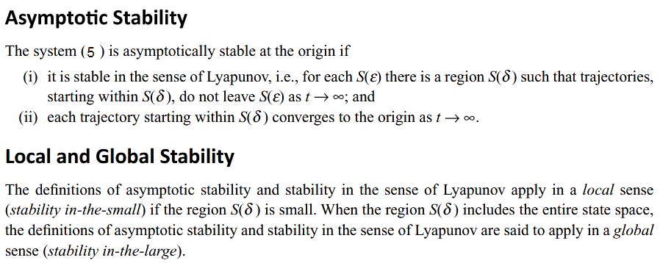
LYAPUNOV STABILITY
LYAPUNOV STABILITY DEFINITIONS

Slide 16
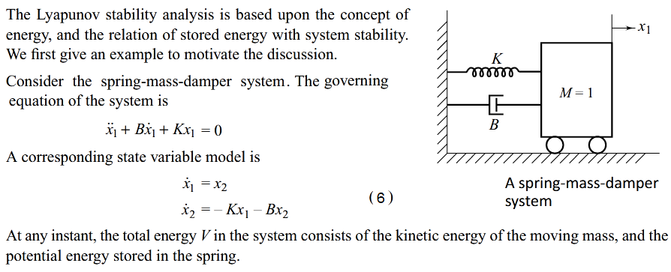
LYAPUNOV STABILITY
LYAPUNOV STABILITY THEOREMS

Slide 17
LYAPUNOV STABILITY
LYAPUNOV STABILITY THEOREMS
Comparing the definitions of stability and mechanical energy, one can easily see some relations between the mechanical energy and the stability concepts described earlier:
• zero energy corresponds to the equilibrium point (x = 0, x´ = 0)
• asymptotic stability implies the convergence of mechanical energy to zero
• instability is related to the growth of mechanical energy
These relations indicate that the value of a scalar quantity, the mechanical energy, indirectly reflects the magnitude of the state vector; and furthermore, that the stability properties of the system can be characterized by the variation of the mechanical energy of the system.

Slide 18
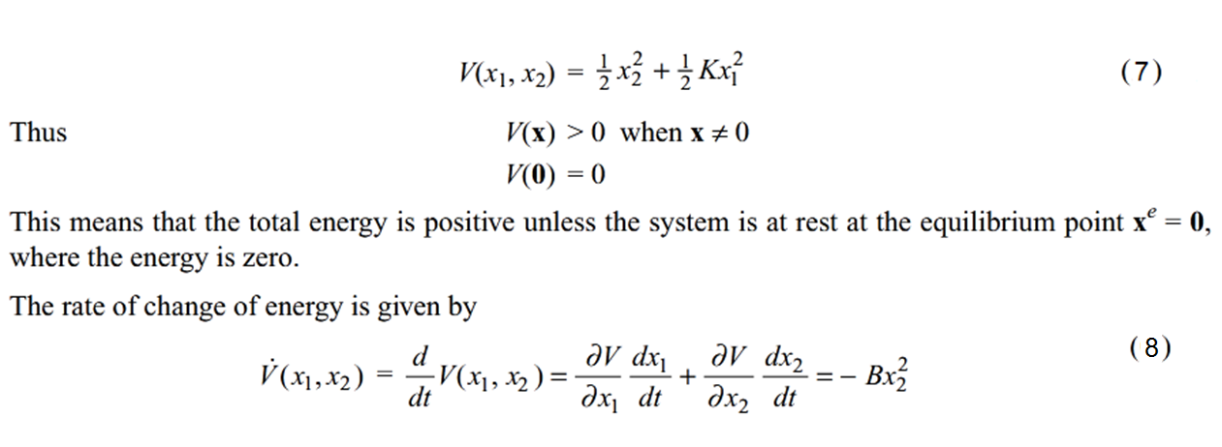
LYAPUNOV STABILITY
LYAPUNOV STABILITY THEOREMS

Slide 19
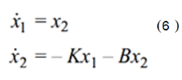
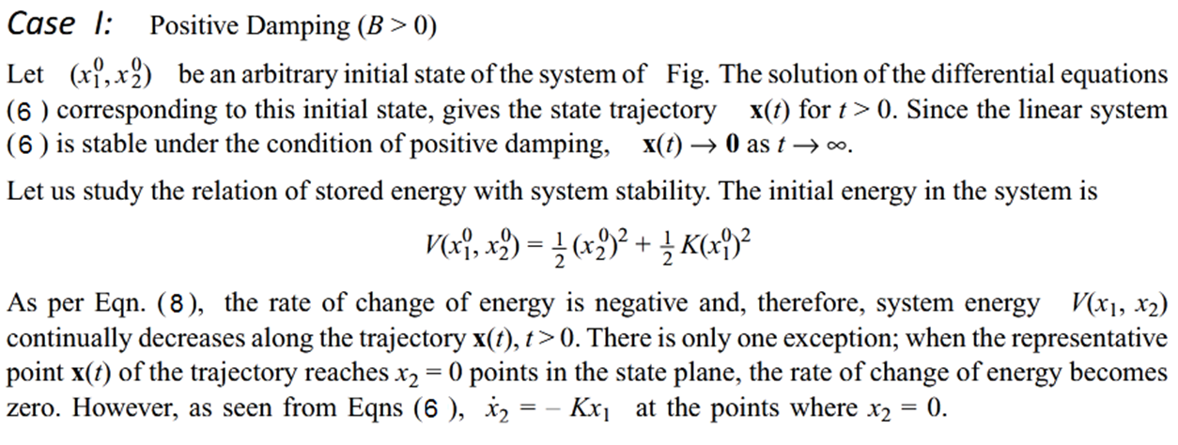
LYAPUNOV STABILITY
LYAPUNOV STABILITY THEOREMS

Slide 20
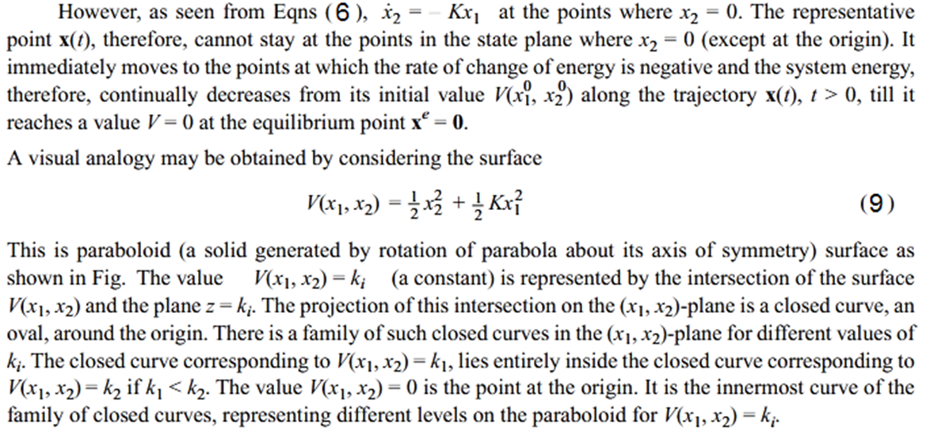
LYAPUNOV STABILITY
LYAPUNOV STABILITY THEOREMS

Slide 21
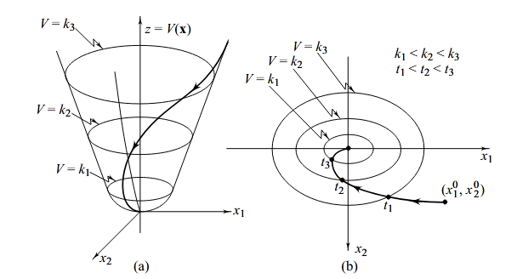
LYAPUNOV STABILITY
LYAPUNOV STABILITY THEOREMS

Slide 22
LYAPUNOV STABILITY
LYAPUNOV STABILITY THEOREMS

Slide 23
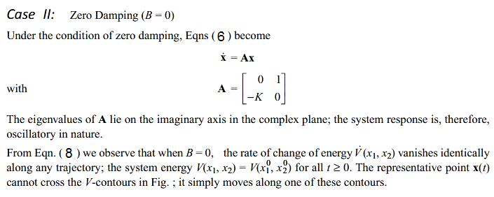
LYAPUNOV STABILITY
LYAPUNOV STABILITY THEOREMS

Slide 24
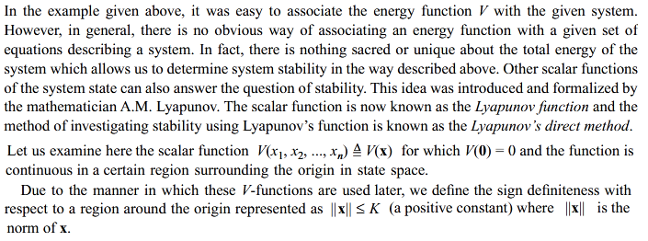
LYAPUNOV STABILITY
LYAPUNOV STABILITY THEOREMS

Slide 25
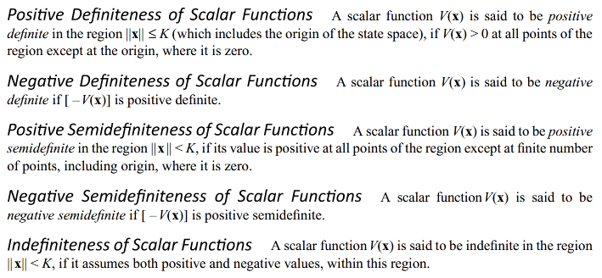
LYAPUNOV STABILITY
LYAPUNOV STABILITY THEOREMS

Slide 26
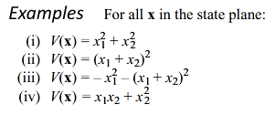
LYAPUNOV STABILITY
LYAPUNOV STABILITY THEOREMS

Slide 27
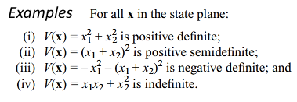
LYAPUNOV STABILITY
LYAPUNOV STABILITY THEOREMS

Slide 28
LYAPUNOV STABILITY
LYAPUNOV STABILITY THEOREMS

Slide 29
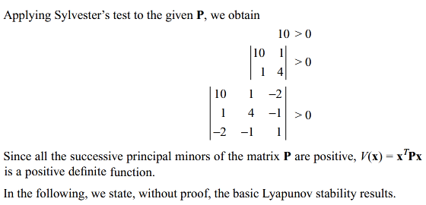
LYAPUNOV STABILITY
LYAPUNOV STABILITY THEOREMS

Slide 30
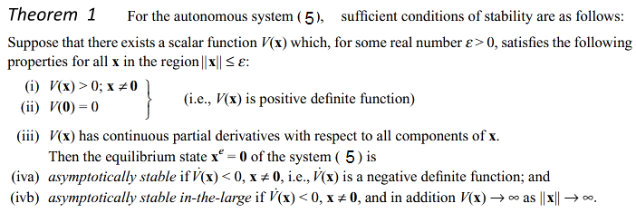
LYAPUNOV STABILITY
LYAPUNOV STABILITY THEOREMS

Slide 31
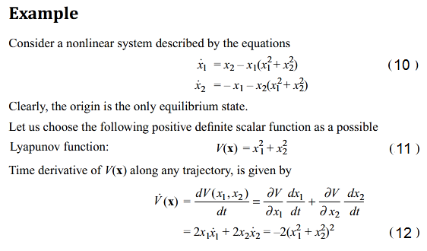
LYAPUNOV STABILITY
LYAPUNOV STABILITY THEOREMS

Slide 32
LYAPUNOV STABILITY
LYAPUNOV STABILITY THEOREMS

Slide 33
LYAPUNOV STABILITY
LYAPUNOV STABILITY THEOREMS

Slide 34
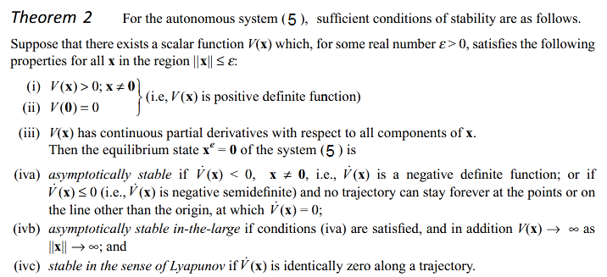
LYAPUNOV STABILITY
LYAPUNOV STABILITY THEOREMS

Slide 35
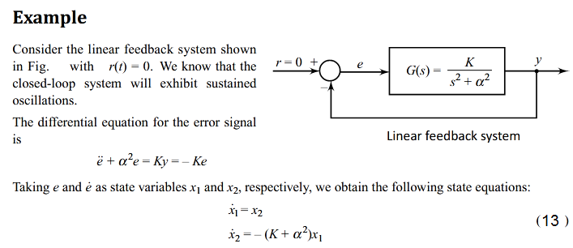
LYAPUNOV STABILITY
LYAPUNOV STABILITY THEOREMS

Slide 36
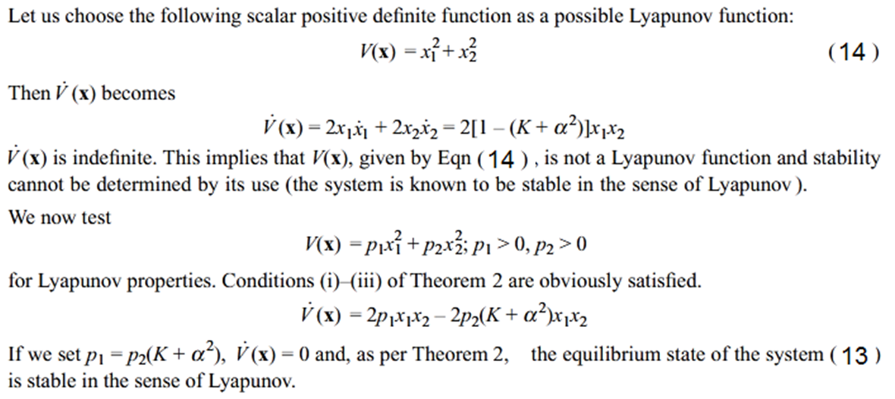
LYAPUNOV STABILITY
LYAPUNOV STABILITY THEOREMS

Slide 37
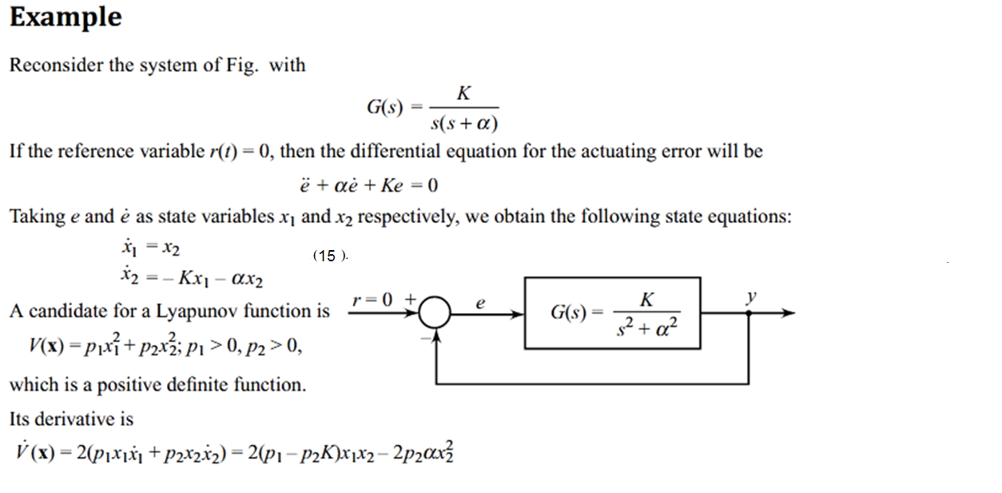
LYAPUNOV STABILITY
LYAPUNOV STABILITY THEOREMS

Slide 38
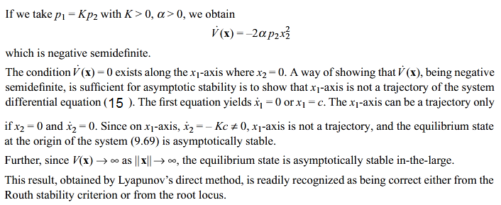
LYAPUNOV STABILITY
LYAPUNOV STABILITY THEOREMS

Slide 39
LYAPUNOV STABILITY
LYAPUNOV STABILITY THEOREMS

Slide 40
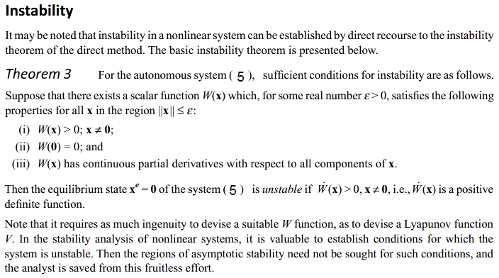
LYAPUNOV STABILITY
LYAPUNOV STABILITY THEOREMS

Slide 41
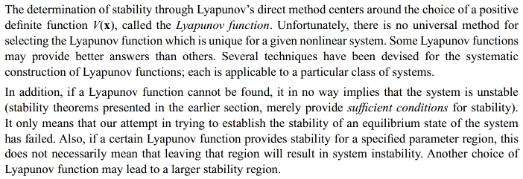
LYAPUNOV STABILITY
LYAPUNOV FUNCTIONS FOR NONLINEAR SYSTEMSILITY THEOREMS

Slide 42
LYAPUNOV STABILITY
LYAPUNOV FUNCTIONS FOR NONLINEAR SYSTEMSILITY THEOREMS

Slide 43
LYAPUNOV STABILITY
LYAPUNOV FUNCTIONS FOR NONLINEAR SYSTEMSILITY THEOREMS

Slide 44
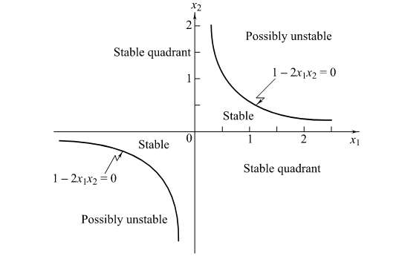
LYAPUNOV STABILITY
LYAPUNOV FUNCTIONS FOR NONLINEAR SYSTEMSILITY THEOREMS

Slide 45
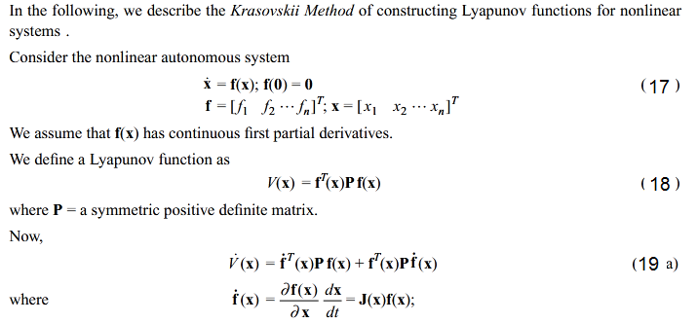
LYAPUNOV STABILITY
LYAPUNOV FUNCTIONS FOR NONLINEAR SYSTEMSILITY THEOREMS
The Krasovskii Method

Slide 46
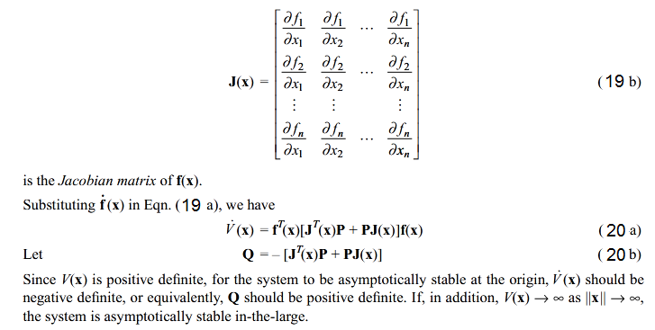
LYAPUNOV STABILITY
LYAPUNOV FUNCTIONS FOR NONLINEAR SYSTEMSILITY THEOREMS
The Krasovskii Method

Slide 47
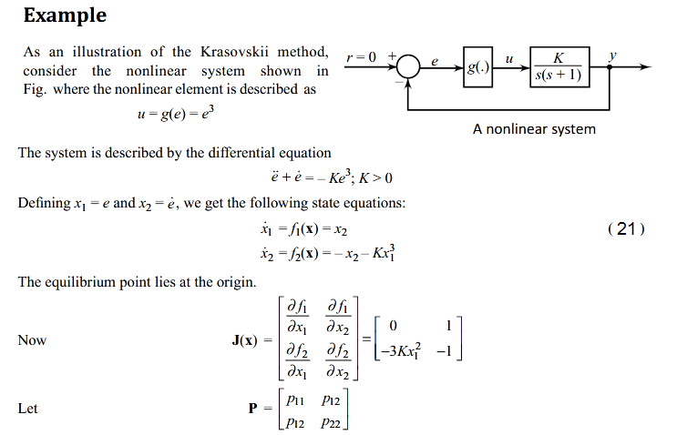
LYAPUNOV STABILITY
LYAPUNOV FUNCTIONS FOR NONLINEAR SYSTEMSILITY THEOREMS
The Krasovskii Method

Slide 48
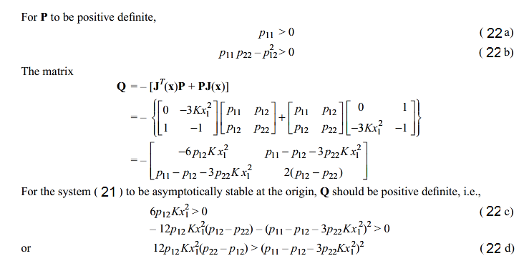
LYAPUNOV STABILITY
LYAPUNOV FUNCTIONS FOR NONLINEAR SYSTEMSILITY THEOREMS
The
Krasovskii
Method

Slide 49
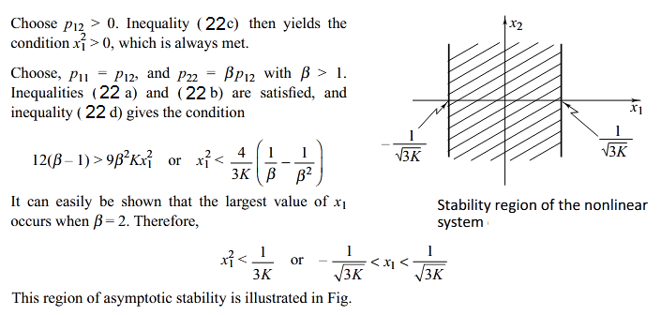
LYAPUNOV STABILITY
LYAPUNOV FUNCTIONS FOR NONLINEAR SYSTEMSILITY THEOREMS
The Krasovskii Method

Slide 50
LYAPUNOV STABILITY
LYAPUNOV FUNCTIONS FOR NONLINEAR SYSTEMSILITY THEOREMS
The Krasovskii Method
Consider the autonomous system defined by (17), with the equilibrium point of interest being the origin, and let J(x) denote the Jacobian matrix of the system. Then, a sufficient condition for the origin to be asymptotically stable is that there exist two symmetric positive definite matrices P and Q, such that $∀x≠0$, the matrix
$Q=−[J^{T}\left(x\right)P+PJ\left(x\right)]$
The function
$$V(x)=f^{T}\left(x\right)Pf\left(x\right)]$$
is then a Lyapunov function for the system.

Slide 51
LYAPUNOV STABILITY
LYPUNOV’S LINEARIZATION METHOD AND LOCAL STABILITY

Slide 52
LYAPUNOV STABILITY
LYPUNOV’S LINEARIZATION METHOD AND LOCAL STABILITY

Slide 53
LYAPUNOV STABILITY
LYPUNOV’S LINEARIZATION METHOD AND LOCAL STABILITY

Slide 54
LYAPUNOV STABILITY
LYPUNOV’S LINEARIZATION METHOD AND LOCAL STABILITY

Slide 55
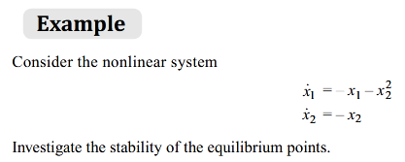
LYAPUNOV STABILITY

Slide 56
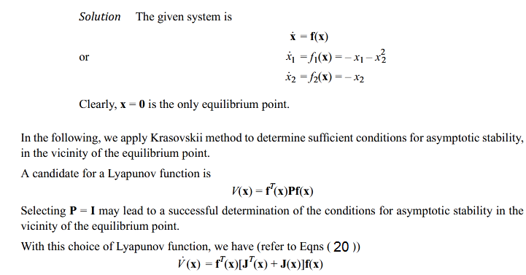
LYAPUNOV STABILITY

Slide 57
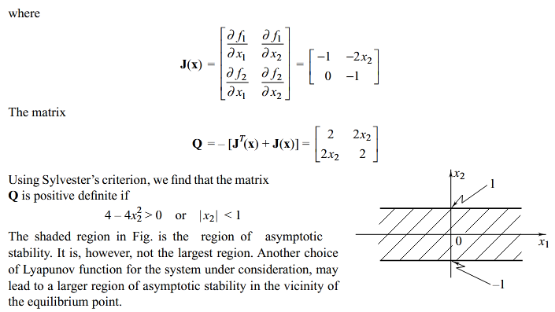
LYAPUNOV STABILITY

