Slide 1

المحاضرة السادسة
MONEY-TIME RELATIONSHIPS AND EQUIVALENCE

Slide 2
المحاضرة السادسة
MONEY
Medium of Exchange --
Means of payment for goods or services;
What sellers accept and buyers pay ;
Store of Value --
A way to transport buying power from one time period to another;
Unit of Account --
A precise measurement of value or worth;
Allows for tabulating debits and credits;

Slide 3
المحاضرة السادسة
CAPITAL
Wealth in the form of money or property
that can be used to produce more wealth.

Slide 4
المحاضرة السادسة
KINDS OF CAPITAL
Equity capital is that owned by individuals who have invested their money or property in a business project or venture in the hope of receiving a profit.
Debt capital, often called borrowed capital, is obtained from lenders (e.g., through the sale of bonds) for investment.

Slide 5
المحاضرة السادسة

Slide 6
المحاضرة السادسة
INTEREST
The fee that a borrower pays to a lender for the use of his or her money.
INTEREST RATE
The percentage of money being borrowed that is paid to the lender on some time basis.

Slide 7
المحاضرة السادسة
Interest
Rate
Money Supply
HOW INTEREST RATE IS DETERMINED
MS₃
MS₁
MS₂
i₃
i_{e}
i₂
Money Demand
Quantity of Money

Slide 8
المحاضرة السادسة
SIMPLE INTEREST
The total interest earned or charged is linearly proportional to the initial amount of the loan (principal), the interest rate and the number of interest periods for which the principal is committed.
When applied, total interest “I” may be found by
I = ( P ) ( N ) ( i ), where
P = principal amount lent or borrowed
N = number of interest periods ( e.g., years )
i = interest rate per interest period

Slide 9
COMPOUND INTEREST
COMPOUND INTEREST
المحاضرة السادسة
Whenever the interest charge for any interest period is based on the remaining principal amount plus any accumulated interest charges up to the beginning of that period.
Period Amount Owed Interest Amount Amount Owed Beginning of for Period at end of period ( @ 10% ) period
1 $1,000 $100 $1,100
2 $1,100 $110 $1,210
3 $1,210 $121 $1,331

Slide 10
ECONOMIC EQUIVALENCE
المحاضرة السادسة
Established when we are indifferent between a future payment, or a series of future payments, and a present sum of money .
Considers the comparison of alternative options, or proposals, by reducing them to an equivalent basis, depending on:
interest rate;
amounts of money involved;
timing of the affected monetary receipts and/or expenditures;
manner in which the interest , or profit on invested capital is paid and the initial capital is recovered.

Slide 11
ECONOMIC EQUIVALENCE FOR FOUR REPAYMENT PLANS OF AN $8,000 LOAN
المحاضرة السادسة
B Plan #1: $2,000 of loan principal plus 10% of BOY principal paid at the end of year; interest paid at the end of each year is reduced by $200 (i.e., 10% of remaining principal)
Year Amount Owed Interest Accrued Total Principal Total end at beginning for Year Money Payment of Year of Year owed at Payment ( BOY ) end of Year
1 $8,000 $800 $8,800 $2,000 $2,800
2 $6,000 $600 $6,600 $2,000 $2,600
3 $4,000 $400 $4,400 $2,000 $2,400
4 $2,000 $200 $2,200 $2,000 $2,200
Total interest paid ($2,000) is 10% of total dollar-years ($2$8,000 LOAN

Slide 12
ECONOMIC EQUIVALENCE FOR FOUR REPAYMENT PLANS OF AN $8,000 LOAN
المحاضرة السادسة
Plan #2: $0 of loan principal paid until end of fourth year; $800 interest paid at the end of each year
Year Amount Owed Interest Accrued Total Principal Total end at beginning for Year Money Payment of Year of Year owed at Payment ( BOY ) end of Year
1 $8,000 $800 $8,800 $0 $800
2 $8,000 $800 $8,800 $0 $800
3 $8,000 $800 $8,800 $0 $800
4 $8,000 $800 $8,800 $8,000 $8,800
Total interest paid ($3,200) is 10% of total dollar-years ($32,000

Slide 13
ECONOMIC EQUIVALENCE FOR FOUR REPAYMENT PLANS OF AN $8,000 LOAN
المحاضرة السادسة
Plan #3: $2,524 paid at the end of each year; interest paid at the end of each year is 10% of amount owed at the beginning of the year.
Year | Amount Owed at beginning Payment ( BOY) | Interest Accrued for Year | Total Money owed at end of Year | Principal Payment | Total
1 | $8,000 | $800 | $800 | $1,724 | $2,524
2 | $6,276 | $628 | $6,904 | $1,896 | $2,524
3 | $4,380 | $438 | $4,818 | $2,086 | $2,524
4 | $2,294 | $230 | $2,524 | $2,294 | $2,524
Total interest paid ($2,096) is 10% of total dollar-years ($20,950)

Slide 14
ECONOMIC EQUIVALENCE FOR FOUR REPAYMENT PLANS OF AN $8,000 LOAN
المحاضرة السادسة
Plan #4: No interest and no principal paid for first three years. At the end of the fourth year, the original principal plus accumulated (compounded) interest is paid.
Year4 | Amount Owed at beginning of Year | Interest Accrued for Year | Total Money owed at end of Year | Principal Payment | Total end of Year Payment1
1 | 8000 | 800 | 8800 | 0 | 0
2 | 8800 | 880 | 9680 | 0 | 0
3 | 9680 | 968 | 10648 | 0 | 0
4 | 10648 | 1065 | 11713 | 8000 | 11713
Total interest paid ($3,713) is 10% of total dollar-years ($37,128

Slide 15
CASH FLOW
DIAGRAMS / TABLE NOTATION
المحاضرة السادسة
i = effective interest rate per interest period
N = number of compounding periods (e.g., years)
P = present sum of money; the equivalent value of one or more cash flows at the present time reference point
F = future sum of money; the equivalent value of one or more cash flows at a future time reference point
A = end-of-period cash flows (or equivalent end-of-period values ) in a uniform series continuing for a specified number of periods, starting at the end of the first period and continuing through the last period
G = uniform gradient amounts -- used if cash flows increase by a constant amount in each period

Slide 16
CASH FLOW DIAGRAM NOTATION
المحاضرة السادسة
2
3
4
5 = N
1
1
2
3
4
5
N=5
1
Time scale with progression of time moving from left to right; the numbers represent time periods (e.g., years, months, quarters, etc...) and may be presented within a time interval or at the end of a time interval.

Slide 17
CASH FLOW DIAGRAM NOTATION
المحاضرة السادسة
A = $2,524
3
1
1
3
4
5 = N
1
2
3
4
5 = N
5 = N
P =$8,000
2
1
Time scale with progression of time moving from left to right; the numbers represent time periods (e.g., years, months, quarters, etc...) and may be presented within a time interval or at the end of a time interval.
2
Present expense (cash outflow) of $8,000 for lender.
3
Annual income (cash inflow) of $2,524 for lender.

Slide 18
المحاضرة السادسة
INTEREST FORMULAS FOR ALL OCCASIONS
relating present and future values of single cash flows;
relating a uniform series (annuity) to present and future equivalent values;
for discrete compounding and discrete cash flows;
for deferred annuities (uniform series);
equivalence calculations involving multiple interest;
relating a uniform gradient of cash flows to annual and present equivalents;
relating a geometric sequence of cash flows to present and annual equivalents;

Slide 19
المحاضرة السادسة
INTEREST FORMULAS FOR ALL OCCASIONS
relating nominal and effective interest rates;
relating to compounding more frequently than once a year;
relating to cash flows occurring less often than compounding periods;
for continuous compounding and discrete cash flows;
for continuous compounding and continuous cash flows;

Slide 20
RELATING PRESENT AND FUTURE EQUIVALENT VALUES OF SINGLE CASH FLOWS
المحاضرة السادسة
Finding F when given P:
Finding future value when given present value
F = P ( 1+i ) ^{N}
(1+i)^{N} single payment compound amount factor
functionally expressed as F = ( F / P, i%,N )
predetermined values of this are presented in column 2 of Appendix C of text.
P
N =
0
F = ?

Slide 21
RELATING PRESENT AND FUTURE EQUIVALENT VALUES OF SINGLE CASH FLOWS
المحاضرة السادسة
Finding P when given F:
Finding present value when given future value
P = F [1 / (1 + i ) ] ^{N}
(1+i)^{-N} single payment present worth factor
functionally expressed as P = F ( P / F, i%, N )
predetermined values of this are presented in column 3 of Appendix C of text;
F
0
N =
P = ?

Slide 22
RELATING A UNIFORM SERIES (ORDINARY ANNUITY) TO PRESENT AND FUTURE EQUIVALENT VALUES
المحاضرة السادسة
Finding F given A:
Finding F given A:
Finding future equivalent income (inflow) value given a series of uniform equal Payments
Finding F given A:
Finding future equivalent income (inflow) value given a series of uniform equal Payments ( 1 + i ) ^{N} - 1
F = A
i

Slide 23
RELATING A UNIFORM SERIES (ORDINARY ANNUITY) TO PRESENT AND FUTURE EQUIVALENT VALUES
المحاضرة السادسة
Finding F given A:
Finding future equivalent income (inflow) value given a series of uniform equal Payments ( 1 + i ) ^{N} - 1
F = A
i
uniform series compound amount factor in [ ]

Slide 24
المحاضرة السادسة
( P / A,i%,N ) =
∑(P / F,i,N )

Slide 25
RELATING A UNIFORM SERIES (ORDINARY ANNUITY) TO PRESENT AND FUTURE EQUIVALENT VALUES
المحاضرة السادسة
Finding A given F:
Finding A given F:
Finding amount A of a uniform series when given the equivalent future value
i
A = F
( 1 + i ) ^{N} -1

Slide 26
المحاضرة السادسة

Slide 27
المحاضرة السادسة
Finding A given F:
Finding amount A of a uniform series when given the equivalent future value
i
A = F
( 1 + i ) ^{N} -1
sinking fund factor in [ ]
functionally expressed as A = F ( A / F,i%,N )
predetermined values are in column 6 of Appendix C of text
F =
1
2
3
4
5
6
7
8
A =?

Slide 28
المحاضرة السادسة
( A / F,i%,N ) = 1 / ( F / A,i%,N )
( A / F,i%,N ) = ( A / P,i%,N ) - i

Slide 29
RELATING A UNIFORM SERIES (ORDINARY ANNUITY) TO PRESENT AND FUTURE EQUIVALENT
المحاضرة السادسة
Finding A given P:
Finding amount A of a uniform series when given the equivalent present value
i ( 1+i )^{N}
A = P ( 1 + i ) ^{N} -1
capital recovery factor in [ ]
functionally expressed as A = P ( A / P,i%,N )
predetermined values are in column 7 of Appendix C of text
P =
1
2
3
4
5
6
7
8
A =?

Slide 30
RELATING A UNIFORM SERIES (DEFERRED ANNUITY) TO PRESENT / FUTURE EQUIVALENT VALUES
المحاضرة السادسة
( A / P,i%,N ) = 1 / ( P / A,i%,N )
If an annuity is deferred j periods, where j < N
And finding P given A for an ordinary annuity is expressed by:
P = A ( P / A, i%,N )
This is expressed for a deferred annuity by:
A ( P / A, i%,N - j ) at end of period j
This is expressed for a deferred annuity by:
A ( P / A, i%,N - j ) ( P / F, i%, j )
as of time 0 (time present)

Slide 31
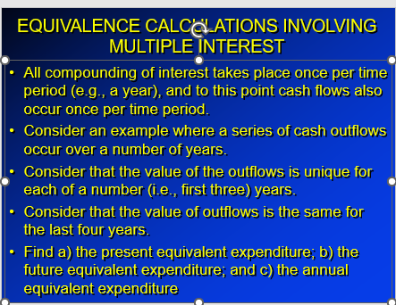
المحاضرة السادسة

Slide 32
المحاضرة السادسة

Slide 33
المحاضرة السادسة

Slide 34
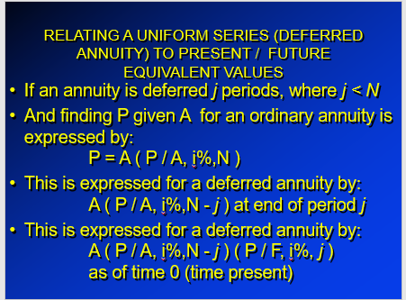
المحاضرة السادسة

Slide 35
EQUIVALENCE CALCULATIONS INVOLVING MULTIPLE INTEREST
المحاضرة السادسة
All compounding of interest takes place once per time period (e.g., a year), and to this point cash flows also occur once per time period.
Consider an example where a series of cash outflows occur over a number of years.
Consider that the value of the outflows is unique for each of a number (i.e., first three) years.
Consider that the value of outflows is the same for the last four years.
Find a) the present equivalent expenditure; b) the future equivalent expenditure; and c) the annual equivalent expenditure

Slide 36
PRESENT EQUIVALENT EXPENDITURE
المحاضرة السادسة
Use P₀ = F( P / F, i%, N ) for each of the unique years:
-- F is a series of unique outflow for year 1 through year 3;
-- i is common for each calculation;
-- N is the year in which the outflow occurred;
-- Multiply the outflow times the associated table value;
-- Add the three products together;
Use A ( P / A,i%,N - j ) ( P / F, i%, j ) -- deferred annuity -- for the remaining (common outflow) years:
-- A is common for years 4 through 7;
-- i remains the same;
-- N is the final year;
-- j is the last year a unique outflow occurred;
-- multiply the common outflow value times table values;
-- add this to the previous total for the present equivalent expenditure.

Slide 37
RELATING A UNIFORM GRADIENT OF CASH FLOWS TO FUTURE EQUIVALENTS
المحاضرة السادسة
Find F when given G:
Find the future equivalent value when given the uniform gradient amount
(1+i)^{N-1} -1 (1+i)^{N-2} -1 (1+i) ¹ -1
F = G + + ... +
Functionally represented as (G/ i) (F/A,i%,N) - (NG/ i)
i i i

Slide 38
المحاضرة السادسة
(N-1)G
(N-2)G
(N-3)G
2G
G
0
1
2
3
N-2
N-1
N

Slide 39
RELATING A UNIFORM GRADIENT OF CASH FLOWS TO ANNUAL AND PRESENT EQUIVALENTS
المحاضرة السادسة
Find A when given G:
Find the annual equivalent value when given the uniform gradient amount
1 N
A = G -
i (1 + i ) ^{N} - 1

Slide 40
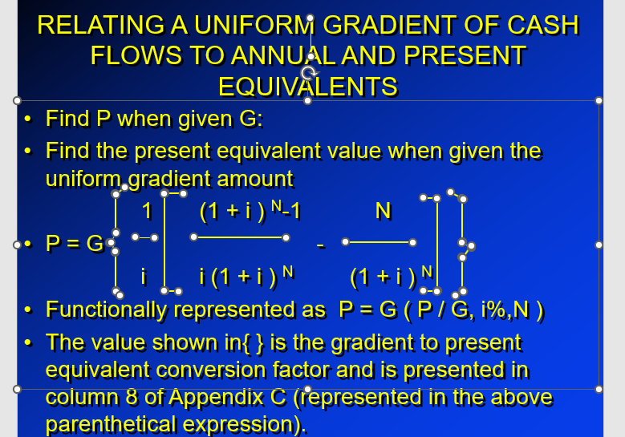
المحاضرة السادسة

Slide 41
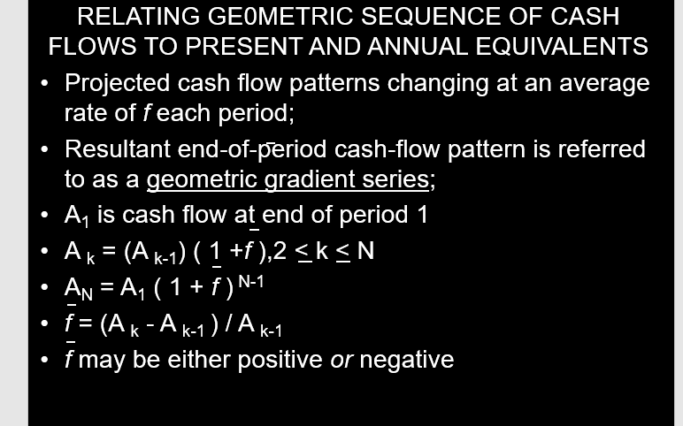
المحاضرة السادسة

Slide 42
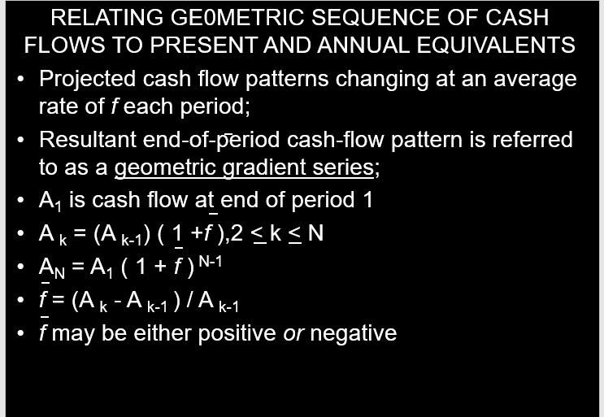
المحاضرة السادسة

Slide 43
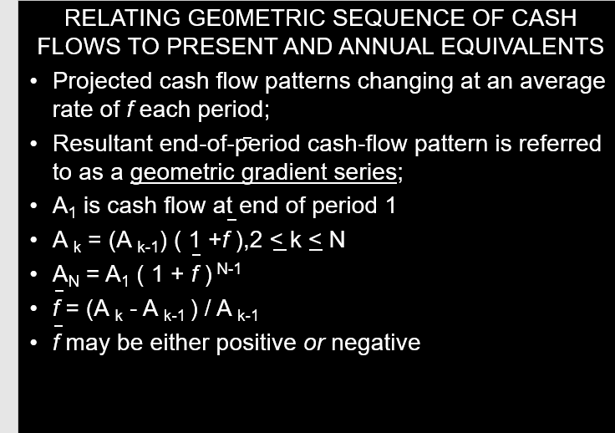
المحاضرة السادسة

Slide 44
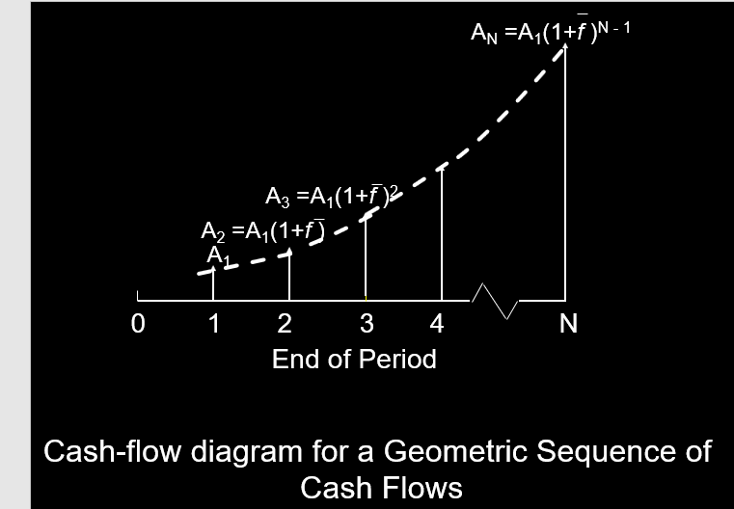
المحاضرة السادسة

Slide 45
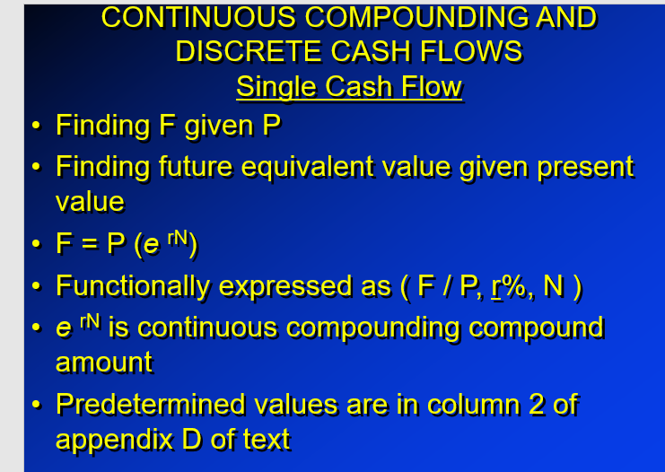
المحاضرة السادسة

Slide 46
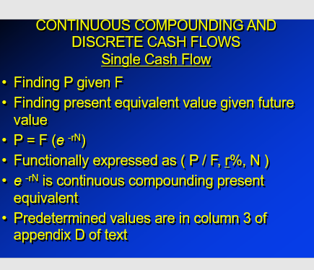
المحاضرة السادسة

Slide 47
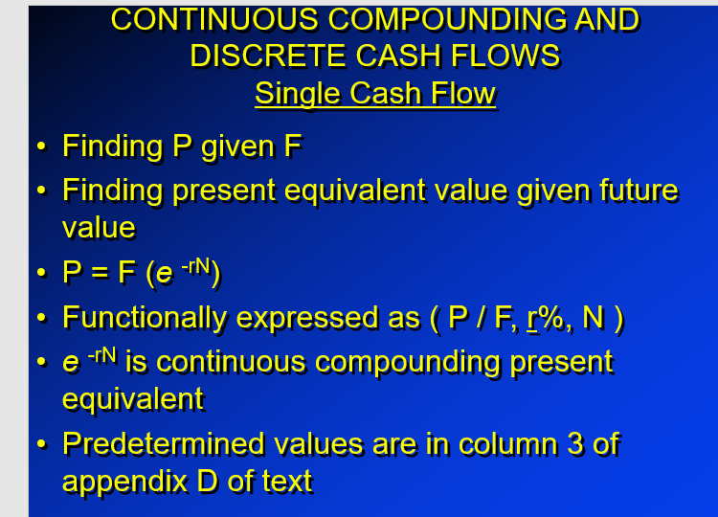
المحاضرة السادسة

Slide 48
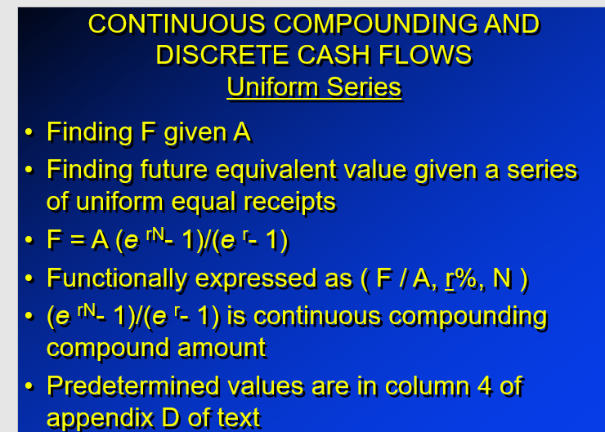
المحاضرة السادسة

Slide 49
CONTINUOUS COMPOUNDING AND DISCRETE CASH FLOWS Uniform Series
المحاضرة السادسة
Finding F given A
Finding future equivalent value given a series of uniform equal receipts
F = A (e ^{rN}- 1)/(e ^{r}- 1)
Functionally expressed as ( F / A, r%, N )
(e ^{rN}- 1)/(e ^{r}- 1) is continuous compounding compound amount
Predetermined values are in column 4 of appendix D of text

Slide 50
CONTINUOUS COMPOUNDING AND DISCRETE CASH FLOWS Uniform Series
المحاضرة السادسة
Finding P given A
Finding present equivalent value given a series of uniform equal receipts
P = A (e ^{rN}- 1) / (e ^{rN} ) (e ^{r}- 1)
Functionally expressed as ( P / A, r%, N )
(e ^{rN}- 1) / (e ^{rN} ) (e ^{r}- 1) is continuous compounding present equivalent
Predetermined values are in column 5 of appendix D of text

Slide 51
المحاضرة السادسة
CONTINUOUS COMPOUNDING AND DISCRETE CASH FLOWS Uniform Series
Finding A given F
Finding a uniform series given a future value
A = F (e ^{r}- 1) / (e ^{rN} - 1)
Functionally expressed as ( A / F, r%, N )
(e ^{r}- 1) / (e ^{rN} - 1) is continuous compounding sinking fund
Predetermined values are in column 6 of appendix D of text

Slide 52
المحاضرة السادسة
CONTINUOUS COMPOUNDING AND DISCRETE CASH FLOWS Uniform Series
Finding A given P
Finding a series of uniform equal receipts given present equivalent value
A = P [e ^{rN} (e ^{r}- 1) / (e ^{rN} - 1) ]
Functionally expressed as ( A / P, r%, N )
[e ^{rN} (e ^{r}- 1) / (e ^{rN} - 1) ] is continuous compounding capital recovery
Predetermined values are in column 7 of appendix D of text

Slide 53
CONTINUOUS COMPOUNDING AND CONTINUOUS CASH FLOWS
المحاضرة السادسة
Continuous flow of funds suggests a series of cash flows occurring at infinitesimally short intervals of time
Given:
a nominal interest rate or r
p is payments per year
[ 1 + (r / p ) ] ^{p} - 1
P = ------------------------------
r [ 1 + ( r / p ) ] ^{p}
Given Lim [ 1 + ( r / p ) ] ^{p} = e ^{r}
For one year ( P / A, r%, 1 ) = ( e ^{r} - 1 ) / re ^{r}
p --> oo

Slide 54
المحاضرة السادسة
CONTINUOUS COMPOUNDING AND CONTINUOUS CASH FLOWS
Finding F given A
Finding the future equivalent given the continuous funds flow
F = A [ ( e^{rN} - 1 ) / r ]
Functionally expressed as ( F / A, r%, N )
( e^{rN} - 1 ) / r is continuous compounding compound amount
Predetermined values are found in column 6 of appendix D of text.

Slide 55
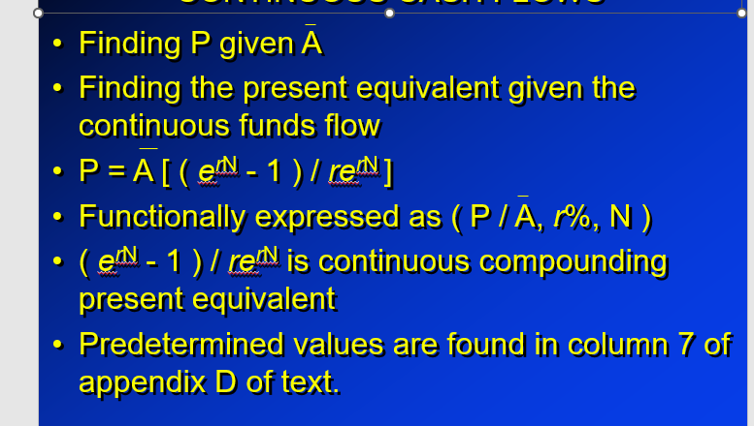
CONTINUOUS COMPOUNDING AND CONTINUOUS CASH FLOWS
المحاضرة السادسة

Slide 56
المحاضرة السادسة

Slide 57
المحاضرة السادسة

Slide 58
المحاضرة السادسة

Slide 59
المحاضرة السادسة

Slide 60
المحاضرة السادسة

Slide 61
المحاضرة السادسة

Slide 62
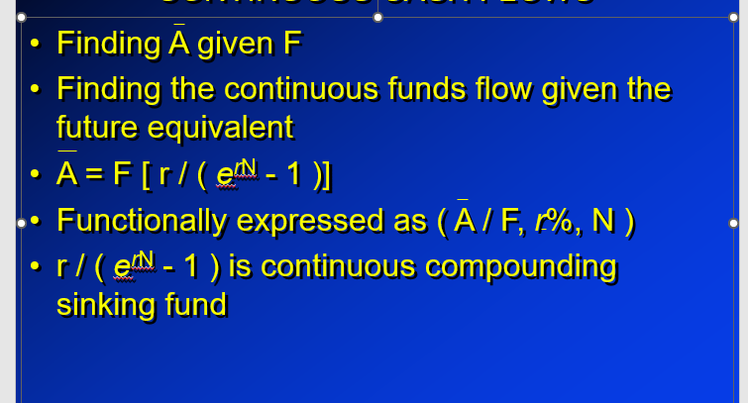
المحاضرة السادسة
CONTINUOUS COMPOUNDING AND CONTINUOUS CASH FLOWS

Slide 63
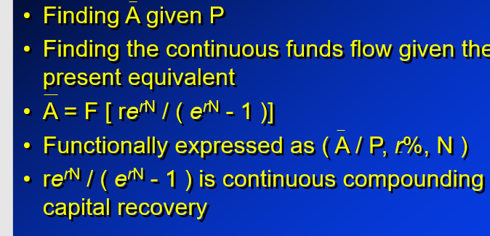
المحاضرة السادسة
CONTINUOUS COMPOUNDING AND CONTINUOUS CASH FLOWS

